Slide 1


Women in Leadership
Pathways to Senior Roles
With: Rachel Holloway
Notes:
Welcome to today.
Women in Leadership
Need Paper & pen or electronic way to make notes
Reflection is a key part of today
A word about language – using male and female, know things are not binary

Slide 2

Approach
Respect
Share experiences and challenges
Interactive approach
Ask questions /comment at any point
Management of time
Notes:
Zoom or in-person ways of working (can rename yourself using the three dots at the top)
Session is a facilitated and structured conversation – sharing experiences, peer to peer learning, use of break out rooms
Mute
Ask questions
Camera on if speaking
Regular breaks, Lunch 12.30 – 12.45 ish
Make sure view is ‘on gallery’ so you can see everyone
Keep camera on unless slides are shared
Use chatbox
I’ll re-admit you if you lose connection – if I lose connection, chat!
Comprehensive handout afterwards
HOW WOULD WE LIKE TO WORK TOGETHER - I’VE STARTED US OF WITH FOUR WAYS HERE THEY ARE – ARE THERE THINK THERE ARE 4 WAYS – ANY MORE THAT YOU SUGGEST?
INFORMAL

Slide 3
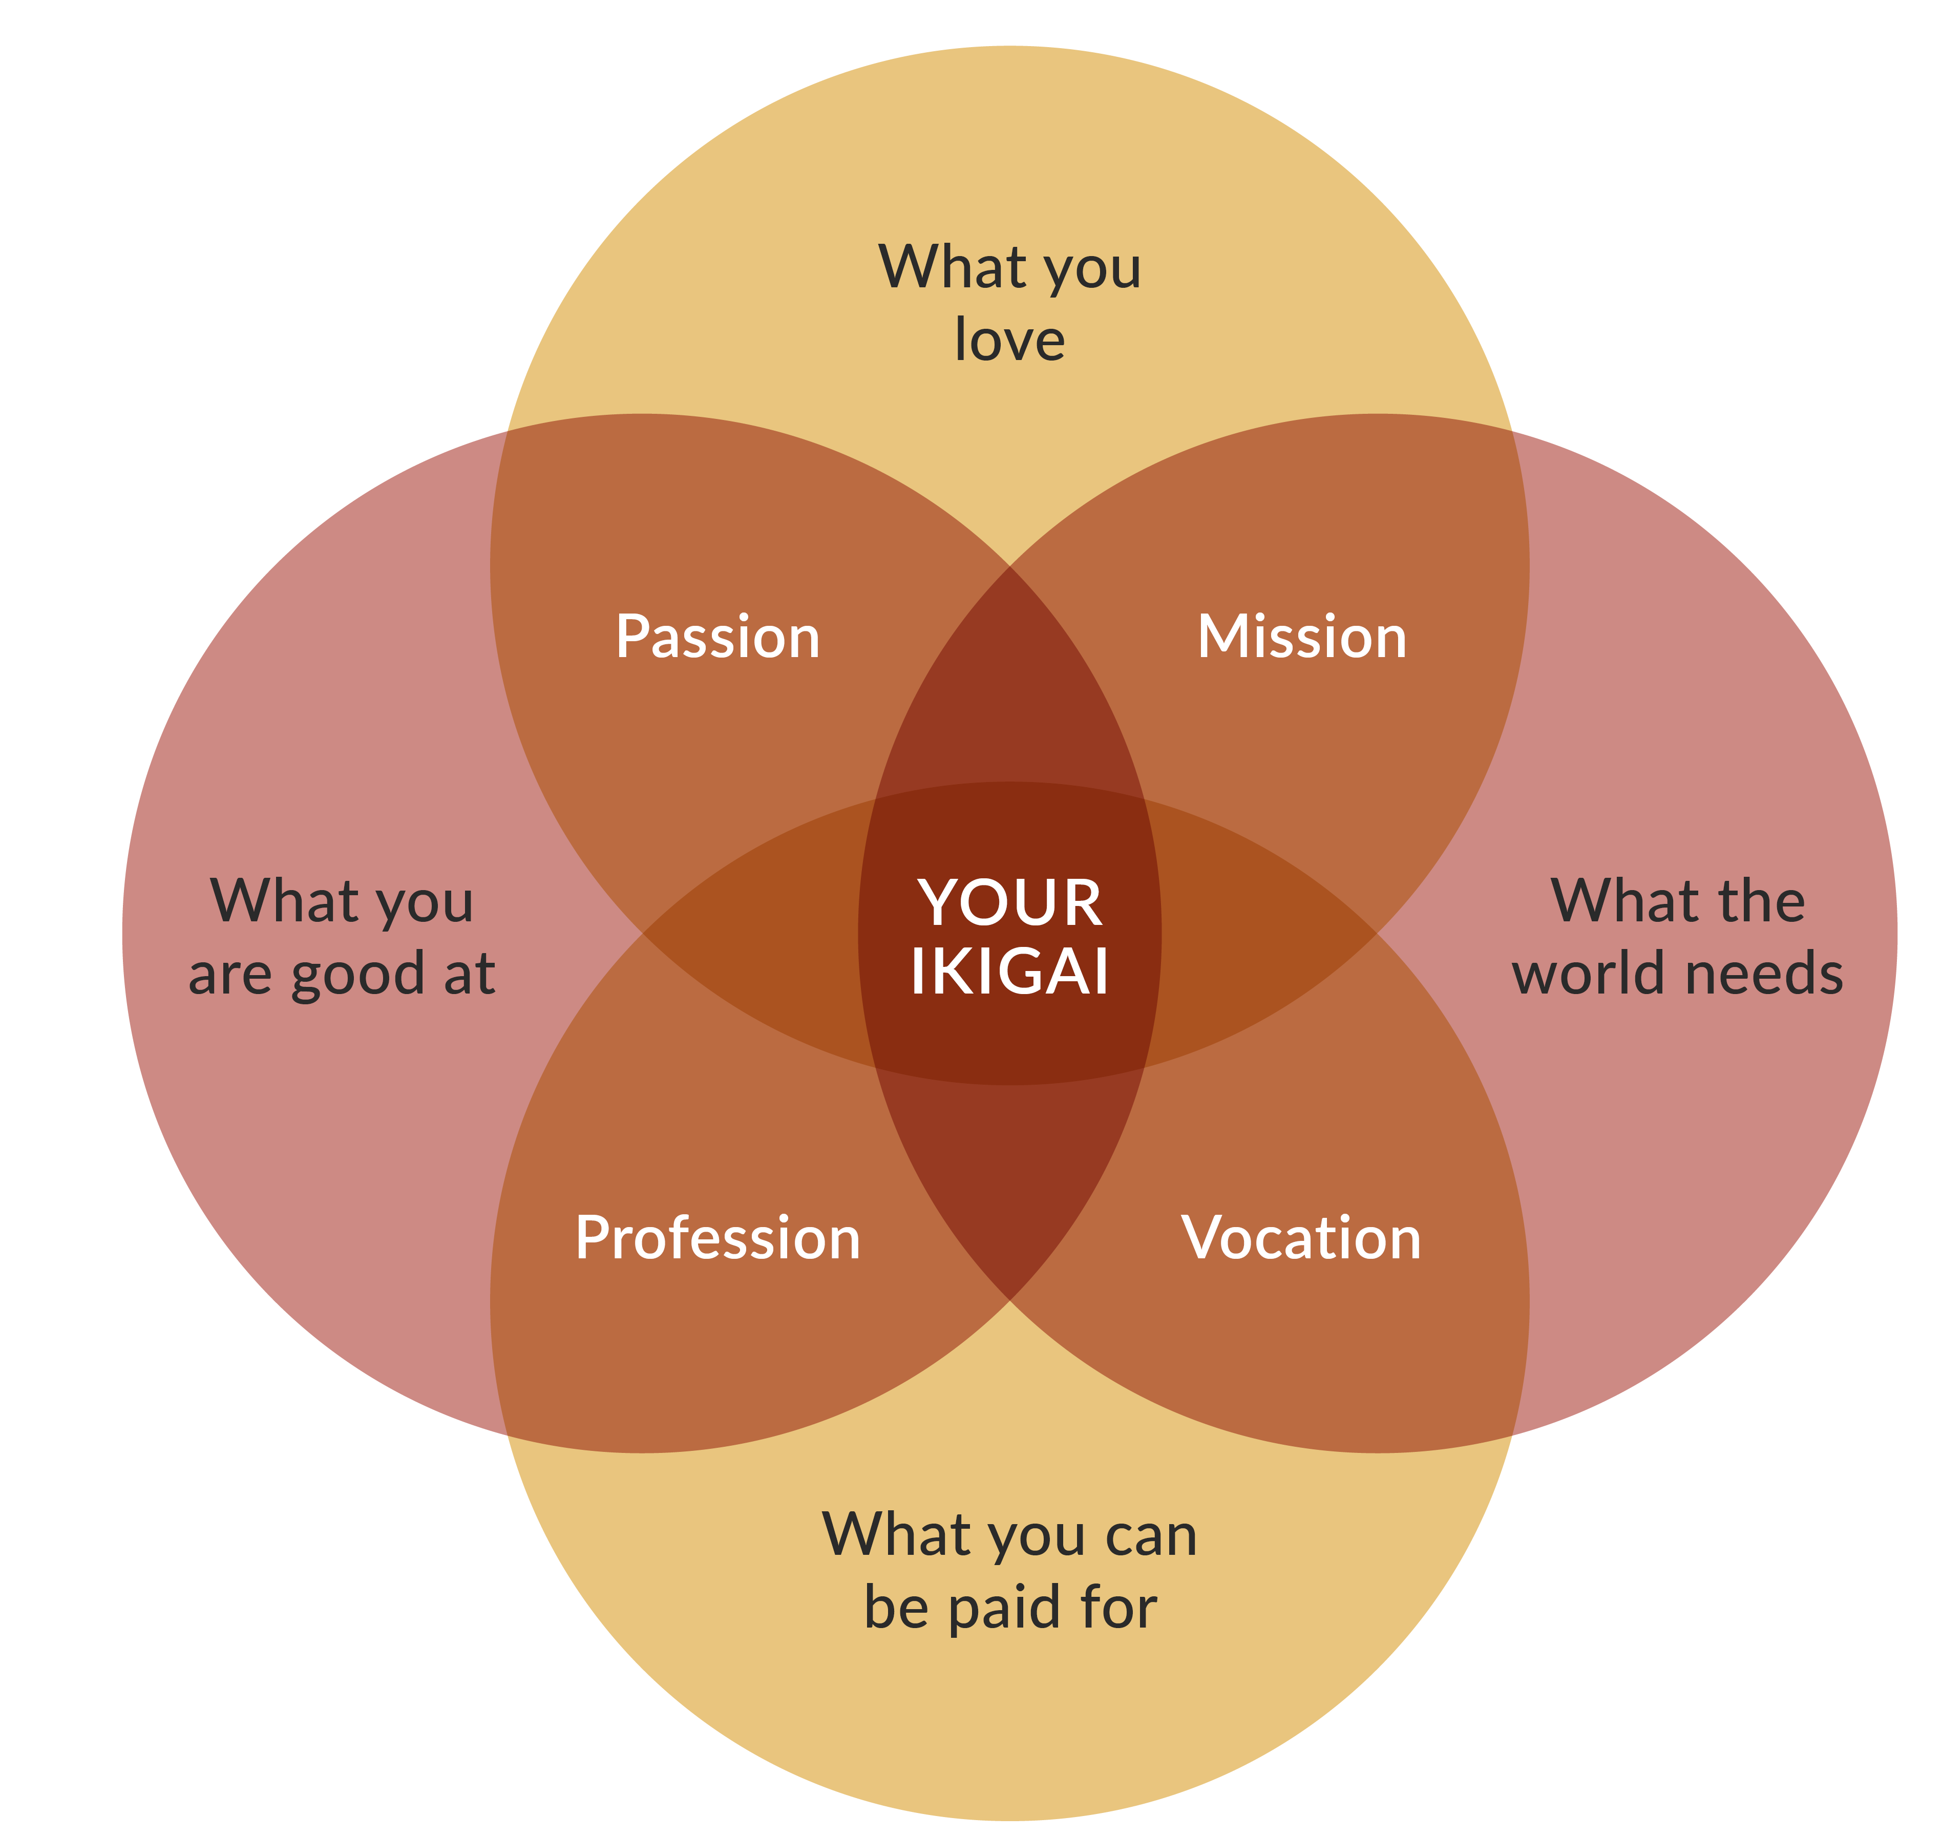
The Cycle of purposeful planning and intentional change
Clarify values & vision
Identify strengths and gaps
Recognise obstacles to achieving the vision
Identify supporters and alliances needed
Develop goals and actions
Get feedback
“Knowing Our Capabilities And Talents Increases Our Self Confidence”
Diana Bilimoria, KeyBank Professor and Chair and Professor of Organizational Behavior at the Weatherhead School of Management, Case Western Reserve University
Implement actions
Notes:
TWO IMAGES
The word “ikigai” is pronounced as ee-kee-guy¹². It’s a Japanese concept that means “a reason for being” or “a reason to live.” This can lead to a fulfilling and meaningful life, as it encourages you to pursue activities that bring joy, satisfaction, and a sense of purpose.
SO THE FIRST TECHNIQUE I OFFER TO YOU IS TO OWN YOUR OWN DEVELOPMENT AND APPLY SOME STRUCTURE TO IT – ADOPT A CYCLE OF PURPOSEFUL PLANNING
SO LET’S TURN TO WANT US TO LOOK AT A CYCLE OF 7 PARTS:
VALUES AND VISION
IDENTIFY STRENGHTS & GAPS
RECOGNISED OBSTACLES TO ACHIEVIING YOUR VISION
IDENTIFY SUPPORTERS & ALLIANCES YOU NEED
DEVELOP GOALS & ACTIONS
IMPLEMENT THE ACTIONS
GET FEEDBACK

Slide 4
Our Time Together
Understand the concept and styles of leadership
Enhance self-awareness and self-confidence to overcome imposter syndrome
Cultivate confident communication skills for more effective leadership
Master the art building support and persuasive negotiating
Recognise and articulate your unique value proposition
Self-reflect to enhance personal growth and leadership effectiveness
Notes:
6 learning objectives
Recognise the value proposition of women in leadership
Develop your leadership style to be authentic and inclusive
Learn to generate buy-in and negotiate persuasively
Build confident communications skills and overcome imposter syndrome
Understand how to develop networks and support through sponsors
Ask why do we need a day like this In 2023?
for the first time in history, women CEOs lead about 10% of
Fortune 500 companies. This is undoubtedly an important milestone. But it underscores the need for more women at all levels of leadership.
And this is not just about representation. Women leaders are good for business:
1. The Ready-Now Leaders report from the Conference Board shows that organizations with at least 30% women in leadership roles are 12x more likely to be in the top 20% for financial performance.
2. Research from Leadership Circle, based on assessments with over 84,000+ leaders and 1.5 million raters (comprising boss, boss’s boss, peers, direct reports, and others), shows that female leaders show up moreDespite all the measurable benefits female leaders bring to organisations, many still do not effectively develop and support them

Slide 5

Does your career feel like…
A You’re a passenger on a Rocketship?
B You’re driving the Rocketship?
C You’re designing the Rocketship?
“A sense of control over our own destinies ensures a sense of self-esteem and a feeling of Empowerment”
Bruce Daisley, Fortitude https://www.findfortitude.net/the-book
Notes:
Taking control of your career
Control doesn’t mean: pre-empting or predicting everything that will come.
Control does mean: being prepared and proactive about your development. When we are in control of our career we can better adapt to the inevitable change and challenge.

Slide 6
INTRODUCTIONS
Name
Role
Reasons for being here today?
‘The one thing that I most want to change is...because …’
What are you most looking forward to in the next three months?
© MyPD 2022
Notes:
SO LET’S INTRODUCE OURSELVES IF YOU COULD PLEASE TELL US YOUR NAME WHAT’S YOUR ROLE WHAT DO YOU DO ON A DAY-TO-DAY BASIS WHAT’S YOUR WHY ARE YOU HERE TODAY ON THIS COURSE
AND COMPLETE THIS SENTENCE I WILL CONSIDER THE DAY SUCCESSFUL IF I…. LET’S LOOK AT WHAT YOU REALLY WANT TO GAIN FROM THIS COURSE. SO LET ME START
MY NAME IS RACHEL HOLLOWAY
I AM FOUNDER OF PARTNERS FOR REFORM, A SMALL BUSINESS AND I HELP PEOPLE TO OVERCOME THEIR CHALLENGES TO ACHIEVE WHAT THEY WANT. I DO THIS THROUGH COACHING AND TRAINING AS WELL AS PROVIDING SPECIALISED ADVICE AND GUIDANCE, FOR EXAMPLE ON MANAGING PROJECTS.
I FIRST EXPERIENCED COACHING IN 2008, AS PART OF A LEADERSHIP DEVELOPMENT PROGRAM AND IT WAS REALLY TRANSFORMATIVE FOR ME. I ACTED AS A MENTOR IN THE CIVIL SERVICE. I BECAME A COACH IN 2016 AND I AM NOW COMPLETING A MASTERS LEVEL QUALIFICATION. I AM A MEMBER OF THE ASSOCIATION OF COACHING, ONE OF THE LEADING PROFESSIONAL BODIES FOR COACHING.
IN TERMS OF SUCCESS. I WILL BE HAPPY IF I CAN CREATE AN ENVIRONMENT WHERE YOU GAIN INSIGHTS THAT YOU CAN APPLY IN YOUR ROLE.

Slide 7

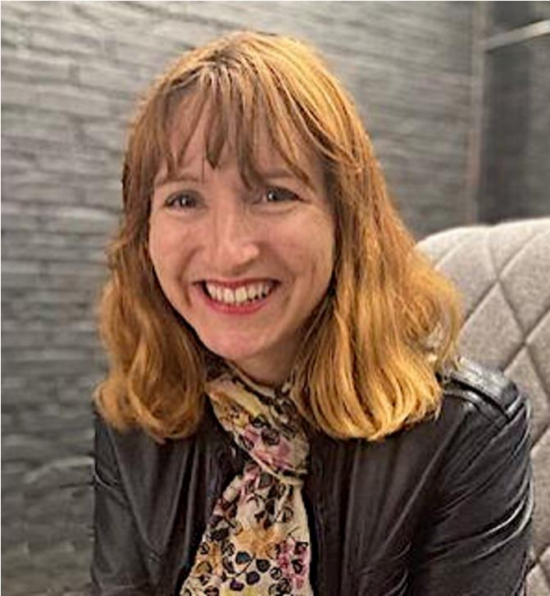




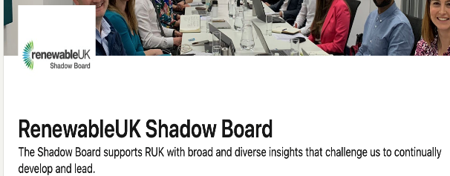

Rachel Holloway
Notes:
VERY SHORT _ ESTABLISH CREDABILITY ETC
COACH, TRAINER. I’VE FIRST-HAND EXPERIENCE OF SENIOR MANAGEMENT TEAM AND I NOW COACH PEOPLE FROM THAT LEVEL TOO. MUCH OF MY WORK IS WITH OTHER COUNTRIES AND I WORKED FOR THE ORGANISATION FOR ECOVNOMIC COOPERATION AND DEVELOPEMENT – WHERE I LED ON COMMUNICATIONS FOR OUR DEPARTMENT ACROSS CULTURES.

Slide 8

Women in Leadership
Notes:
Highlight the unique perspectives, skills, and qualities that women bring to leadership roles.
Discuss research showcasing the positive impact of gender diversity in leadership.
Explore the importance of diverse leadership teams in driving innovation and achieving organizational success.

Slide 9

The context
Women are half the world’s population
Working two thirds of the world’s working hours
Receiving 10% of the World’s Income
Owning less than 1% of the World’s Property
Responsible for 70-80% of household spending power
Notes:
Let’s look at the wider context. The overall message is that, despite being half of the world's population and contributing significantly to the workforce, women face substantial economic inequalities in terms of income and property ownership.
We need to advocate for gender equality to address the systemic issues that contribute to these disparities.
Women suffer from lack of access to decent work and face occupational segregation and gender wage gaps.
In many situations, they are denied access to basic education and health care and are victims of violence and discrimination. They are under-represented in political and economic decision-making processes.,
Edwina Dunn Founder the Female Lead & Tesco clubcard o, she masterminded the data science behind Tesco The Hidden Pound quoting Forbes Women drive 70-80% of all consumer purchasing decisions.

Slide 10

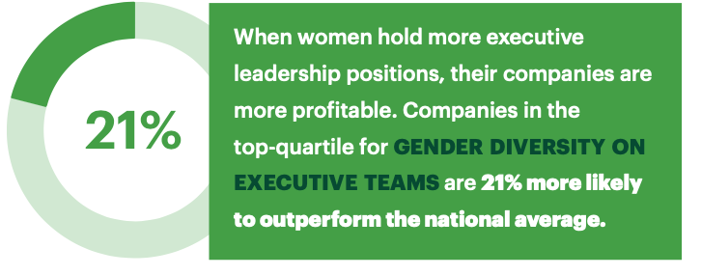
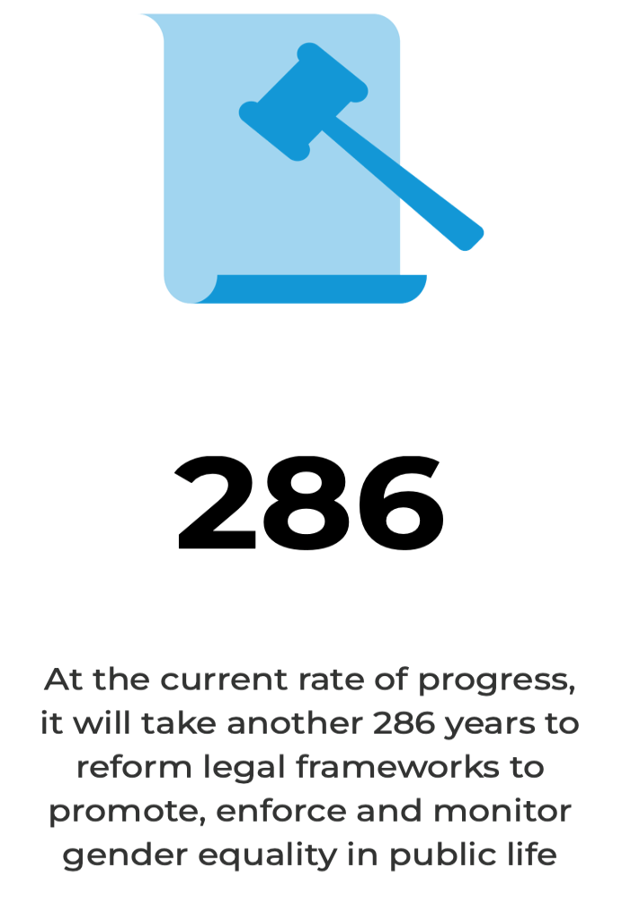
Global equality
“Women in management roles increased by one percentage point to 41% since 2011”
The Everyone Economy, The Chartered Management Institute, 2022
Check out progress https://unstats.un.org/sdgs/dataportal
Notes:
So let’s look at efforts to create equality. In 2015, 17 Sustainable Development Goals (SDGs) were created - urgent call for action by all countries - They recognise that ending poverty and other deprivations must go hand-in-hand with strategies that improve health and education, reduce inequality, and spur economic growth.
One of them is no. 5 gender equality - Achieve gender equality and empower all women's and girls.
Gender inequalities are still deep-rooted in our societies.
The SDG is good progress – but there is still more to do. All countries monitor their progress against achieving the goal. It will take 286 years to reform legal frameworks to promote, enforce and monitor gender equality in public life
Why should we do support global equality this, aside from it being the right thing to do?
Organizations that hold more executive leadership positions are more profitable.

Slide 11
Diversity is linked to growth
Diversity is part of recruiting top talent
Diversity initiatives help to engage and retain employees
Diversity can improve decision making
A clear correlation between companies' gender diversity and profitability: 25% more likely to have above average profitability - a source of competitive advantage and an enabler of growth
McKinsey, Diversity wins: How inclusion matters 2020
A survey of the Institute of Directors Members found that a diverse board strongly drives effective business, 64% agree.
Diverse leadership reduces groupthink and increases the ability to innovate
The Future of Business: harnessing diverse talent for success. The IoD, 2023
11
Notes:
There is a clear business case for increasing the share of women in leadership teams.
There is already evidence that valuing and prioritising gender diversity in leadership benefits companies in multiple areas, improving their market share, return on investment, and culture. Many studies indicate that women in leadership are also highly motivated to make a positive impact on the world.
A 2016 Credit Suisse analysis found that Companies where women made up at least 15 percent of senior managers had 18 percent higher profitability, and companies with a woman as CEO experienced 19 percent higher profitability.
This is a quote from 2022 research on leadership – link to a great white paper comedy Adam’s the chief learning officer at leadership circles
In a report from McKinsey entitled ‘Diversity wins: How inclusion matters’, published in May 2020, the report’s authors said, “our 2019 analysis finds that companies in the top quartile for gender diversity on executive teams were 25 percent more likely to have above-average profitability than companies in the fourth quartile – up from 21 percent in 2017 and 15 percent in 2014.”
3 key points; business case for diversity is clear:
Diversity is part of recruiting top talent
Past research has found that gender-role stereotyping is reinforced in how competencies are defined, with the result that women are consistently rated lower than men in terms of leadership ability
Diversity initiatives help to engage and retain employees
Discrimination, exclusion and barriers at work are ‘push’ factors that can cause staff to
leave their employer.
Conversely, organisations perceived by their staff as committed to D&I register higher rates of employee engagement and retention.
In particular, millennial (ages 26-41) and Generation Z (18-25) are more likely to want to stay with their organisation for more than five years when they feel satisfied with their employer’s efforts to create a diverse and inclusive workplace.
Diversity can improve decision making
Private sector organizations such as McKinsey argue that building a diverse workforce reflecting their customer base allows them to better understand consumer perspectives, spot and react to market developments, because staff are likely to operate in different networks and engage with a wider pool of stakeholders.
Similarly, the Good Governance Institute has made the case that diversity in the NHS workforce results in better access and quality of care for its patients. The civil service helps formulate and deliver policy for all of UK society, so it is vitally important for it to get officials with varied backgrounds and experiences around the table

Slide 12

Diversity is part of recruiting top talent
“Diversity in leadership ranks is proven to have a strategic advantage. It’s important not only to hire and promote female leaders but to encourage their development early and to help them gain as much business experience and knowledge as they can in roles that may still be male-dominated.
Women make that shift from ‘less effective’ to ‘more effective’ sooner than men. If we start building more diverse teams and organizations now, businesses will be better for it, and the world will be better for.”
Cindy Adams, Chief Learning Officer, Leadership Circle
https://leadershipcircle.com/wp-content/uploads/2022/03/Research-on-Female-and-Male-Leaders-White-Paper-2022-03-17.pdf
Notes:
There is a clear business case for increasing the share of women in leadership teams.
There is already evidence that valuing and prioritising gender diversity in leadership benefits companies in multiple areas, improving their market share, return on investment, and culture. Many studies indicate that women in leadership are also highly motivated to make a positive impact on the world.
A 2016 Credit Suisse analysis found that Companies where women made up at least 15 percent of senior managers had 18 percent higher profitability, and companies with a woman as CEO experienced 19 percent higher profitability.
This is a quote from 2022 research on leadership – link to a great white paper comedy Adam’s the chief learning officer at leadership circles

Slide 13
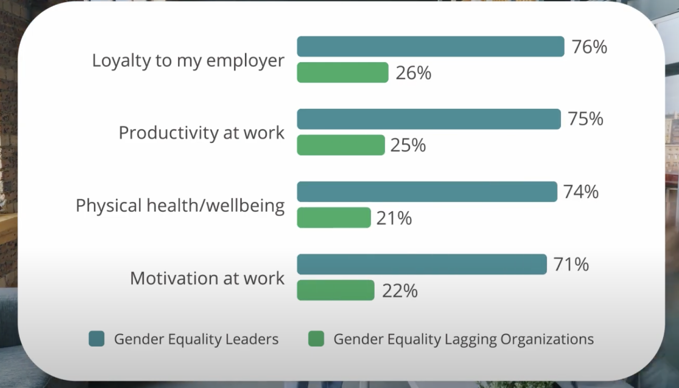
Gender Equality Report 2024
Deloitte Women @ Work 2024: A Global Outlook
62% of women that work for Gender Equality Leaders plan to stay for 3+ years
Notes:
The report segments companies thar are leading in gender equality and those that are not – that are flagging
What they found was that in gendered equality leaders, the women report:
They have greater loyalty to their employer
They are more productive at work
They have increased physical health and wellbeing
And they are more motivated at work
Deloitte Women at Work 2024: A Global Outlook Representing the views of 5,000 women from workplaces across 10 countries, Women @ Work: A Global Outlook seeks to understand the lived experiences of women at work—and the ways in which aspects of their lives outside of work can impact these experiences.

Slide 14
Mind the Gap
60% of the developmental feedback men received was linked to specific business outcomes—and therefore actionable—compared to only 40% of feedback women received, also about style: 66% of women received negative feedback on their style, such as “You can sometimes be abrasive,” compared to less than 1% of men.
Men apply for jobs when they meet 60% of the hiring criteria, while women wait until they meet 100%.
Women are often given less credit for successful outcomes and blamed more for failure.
Shelley Correll and Caroline Simard, “Research: Vague Feedback Is Holding Women Back,” Harvard Business Review, April 29, 2016, https://hbr.org/2016/04/research-vague-feedback-is-holding-women-back.
Georges Desvaux, Sandrine Devillard-Hoellinger, and Mary C. Meaney, “A Business Case for Women,” The McKinsey Quarterly, September 2008, 4, http://www.talentnaardetop.nl/uploaded_files/document/2008_A_business_case_for_women.pdf
Madeline E. Heilman and Michelle C. Hayes, “No Credit Where Credit Is Due: Attributional Rationalization of Women’s Success in Male-Female Teams,” Journal of Applied Psychology 90, no. 5 (2005): 905–26; Michelle C. Hayes and Jason S. Lawrence, “Who’s to Blame? Attributions of Blame in Unsuccessful Mixed-Sex Work Teams,” Basic and Applied Social Psychology 34, no. 6 (2012): 558–64.
Kieran Snyder, “The Abrasiveness Trap: High-Achieving Men and Women Are Described Differently in Reviews,” Fortune, August 26, 2014, http://fortune.com/2014/08/26/performance-review-gender-bias/.
Notes:
FEEDBACK : read this “Jessica is really talented, but I wish she’d be less abrasive. She comes on too strong.” Her male counterpart? “Steve is an easy case, smart and great to work with. He needs to learn to be a little more patient, but who doesn’t?” These statements, uttered by an engineering manager who was preparing performance reviews, were the catalyst for linguist Kieran Snyder to see if she could quantify the double standards in the way male and female employees are evaluated.
Abrasive alone was used 17 times to describe 13 different women, but the word never appeared in men’s reviews.
The One Word Men Never See In Their Performance Reviews - Fast Company
Shelley Correll and Caroline Simard, “Research: Vague Feedback Is Holding Women Back,” Harvard Business Review, April 29, 2016, https://hbr.org/2016/04/research-vague-feedback-is-holding-women-back.
Georges Desvaux, Sandrine Devillard-Hoellinger, and Mary C. Meaney, “A Business Case for Women,” The McKinsey Quarterly, September 2008, 4, http://www.talentnaardetop.nl/uploaded_files/document/2008_A_business_case_for_women.pdf
Madeline E. Heilman and Michelle C. Hayes, “No Credit Where Credit Is Due: Attributional Rationalization of Women’s Success in Male-Female Teams,” Journal of Applied Psychology 90, no. 5 (2005): 905–26; Michelle C. Hayes and Jason S. Lawrence, “Who’s to Blame? Attributions of Blame in Unsuccessful Mixed-Sex Work Teams,” Basic and Applied Social Psychology 34, no. 6 (2012): 558–64.
Kieran Snyder, “The Abrasiveness Trap: High-Achieving Men and Women Are Described Differently in Reviews,” Fortune, August 26, 2014, http://fortune.com/2014/08/26/performance-review-gender-bias/.
In July 2022, 39.6% of FTSE 100 directorships and 38.9% of FTSE 250 directorships were held by women – so 39%

Slide 15
Value Proposition
Recognise the value proposition of women in leadership
Notes:
Going to look at our value as individuals now.
Ask what’s a value statement

Slide 16

Leadership Value Proposition
The value that you bring to your organisation, teams and colleagues, peers and wider stakeholders.
Your VP:
An aggregation of qualities, characteristics and benefits that delivers a unique value to your stakeholders.
A personal code of conduct that is the foundation for your leadership thinking, behaviour and actions.
Notes:
A value proposition is a statement that clearly identifies the benefits a company's products and services will deliver. A well-crafted value proposition differentiates the company and/or its specific product or service in the marketplace and among a target market or target audience.
Your Leadership Value proposition is your unique contribution, the value that you add, that will differentiate you from your peers. Important to understand our value proposition
You elevate your status and drive your career by adding value. It’s a vital concept for thinking about your career.
It’s impossible to demonstrate your value to others if you cannot see it yourself!
Beverly Smith:
“It’s about understanding what you do well and be able to articulate that clearly so you can demonstrate what that means in ppractice. This means being able to analyse, interpret and apply your experience in a range of different settings so that your value is crystal clear.
Know what skills, strengths and talents you have and understand what they enable you to do with them.
This will enable you to make moves outside your immediate realm of experience and help you to be seen through a new lens by people who may not previously have recognised some of your skills and the value you add.”
A question to ask yourself is:
What benefits/value does my organisation get from me being there?
Not the same as your own personal values or a job description
Men often showcase their value, women talk about their job descriptions – BBC example – men showcasing themselves and each other, tag teams
2 examples; CEO & Christine Lagarde

Slide 17
What’s your Value Proposition?
Where and how do you add value?
What Makes You Special?
Who Are You?
  You may not think you have one, but your presence creates it. Components include
    CV
    LinkedIn Profile
    Cover letter
    Meetings
    Interviews
Notes:
You use your Personal Value Proposition all the time, very often without even realising it.
Comprises of 3 components:
Who are you?
What makes you special?
Where and how do you add value?

Slide 18
Who are YOU?
What are my top skills?
What experience do I have?
What are my strengths?
What problems am I good at solving?
What am I passionate about
What are my core values?
What is my vision for my future?
What motivates me?
‘Great step to prepare for Powerful Career Conversations’ https://www.linkedin.com/pulse/how-well-prepared-career-conversation-your-manager-oglethorpe/
Notes:
Knowing our value requires reflection on who we are & what drives us.
Needs a focus on Head and heart
Here are some of the areas that can help illuminate our thinking

Slide 19
Christine Lagarde
President of the European Central Bank
Authentic
Does not compromise personal style to appeal to stereotypes about women
Confident & Determined
Inspires & develops others
Diverse Experience
Government, the Private sector, and the Non-profit sectors
Activist
Action not just words.
SABR
Refuses to attend meeting where she is the only woman
Strong and Considerate
Prepared to take risks Respectful of others
Communication
Builds strong relationships produce easy communication without need for protocol
Notes:
President of the European Central Bank, ranked as Number two on the 2023 Forbes’ list of The World’s 100 Most Powerful Women. (This year’s top listees, European Commission President Ursula von der Leyen (#1))
Talk through each circle briefly – this is what it looks like in practice
The burden of one – she refuses to attend a meeting where she’ll be the only woman there – she lifts as she climbs
Need to feel more comfortable at these levels
Confidence – is always being prepared
Thoughts and comments?

Slide 20
What’s your Value Proposition?
What’s your Value Proposition?
?
?
?
?
?
Notes:
Activity: Value proposition of women leadership
Small groups with feedback and facilitated discussion.
In feedback, note gender stereotyping – theirs and others.
Start crafting own leadership value proposition
Allow 12-15 minutes in 4 groups – each group will be asked to report back
KEY HERE TO MAKE NOTES – OFTEN PROVIDES KEY CONTENT FOR THE REST OF THE DAY
How much of the lists are leadership behaviour and how much are women’s leadership behaviours?
Have they fallen into stereotyping? Need to find a different way of thinking about leadership – Balanced Leadership is what we need to be moving towards.
SELF REFLECTION MOMENT – SWITCH OFF CAMERAS AND MAKE SOME NOTES allow 5 minutes. Take feedback – how easy did you find it?
What do you offer as a leader that sets you apart?
What values and beliefs do you hold that drive your behaviours?
What is your vision for the future of your team and the individuals who comprise your team?

Slide 21

Feedback
Notes:
Ask fort comments

Slide 22
Tip: Reflected Best Self Exercise
1. Identify your personal strengths by asking people for stories of you at your best. The stories can be anything: work-related, personal experiences, achievements, if they represent you at your best!
2. Organise your stories to pull out insights and your strengths
3. Make an action plan to build on them.
Notes:
A feedback exercise where you ask one specific question, collate the responses and then weave a narrative about yourself. Very, very powerful to do – captures your value as others see it. This can be a very useful mirror and the examples given bring things to life.
Identify your personal strengths by asking people for stories of you at your best. The stories can be anything: work-related, personal experiences, achievements, as long as they represent you at your best.
Organize your stories to pull out insights and your strengths
Make an action plan to build on them.
Very useful for adding to your own value proposition, it provides insights into your presence and impact of you on others
Example of the question to email. Refer people to the HBR link at this point on the slide https://hbr.org/2005/01/how-to-play-to-your-strengths

Slide 23
Find your Leadership Voice
Your Leadership Preferences
Inclusive Leadership
Notes:
Finding Your Voice as a Leader:
Explore different leadership styles and their effectiveness in diverse settings.
Discuss the importance of authenticity and integrity in leadership.
Provide practical tips for developing and expressing your leadership voice with confidence.
Know your value and your worth is the first essential step. Keep asking, what’s your value? Then own your worth and know your own value, important personally and professionally.
Decide how you want to show up in the world. How are you going to show up in the world? How you show up matters – Jane Campion quote – ‘Act as if what you do makes a difference – because it does’
About paying attention and acting intentionally – decide what you want people to be thinking and saying about you. You get to choose and that is what the next section is going to focus on.
Leadership Styles

Slide 24
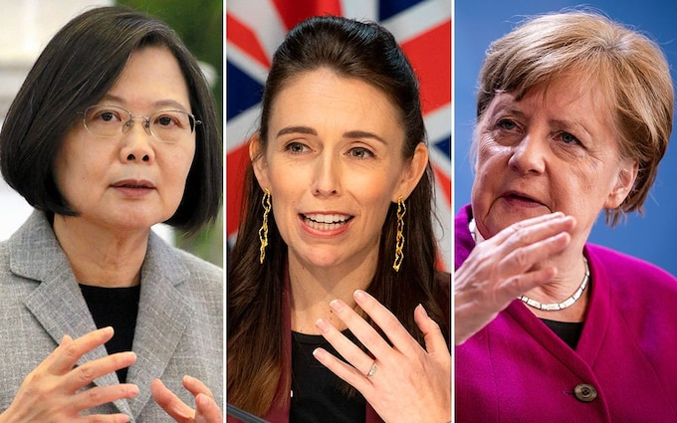
Female leaders
“Female leaders show up in a noticeably different way than male leaders in terms of building caring connections, mentoring and developing others, and exhibiting concern for the community. In today’s business environment, this acts as a superpower.”
Cindy Adams, CEO
"The world...needs leaders with compassion. And that means the world needs more female leaders. Biologically, females have more sensitivity about others' wellbeing”
The Dalai Lama, Atlantic Magazine 2013
“Integrating leadership into one’s core identity is particularly challenging for women, who must establish credibility in a culture that is deeply conflicted about whether, when, and how they should exercise authority.”
Women Rising: The Unseen Barriers, Herminia Ibarra, Robin J. Ely, and Deborah M. Ko
Notes:
So, what is does it mean to be a female leader?
Integrating leadership is challenging
https://leadershipcircle.com/wp-content/uploads/2022/03/Research-on-Female-and-Male-Leaders-White-Paper-2022-03-17.pdf
So, what is does it mean to be a female leader? I worked with Jacinda Ardern In the Cabinet Office
Integrating leadership is challenging

Slide 25
Inclusive Leadership
Athena Values
Leadership values and behaviours that matter to team members include:
Being human
Authenticity
Clarity of purpose
Building connectivity
Collaborative working
Being humble
Adapting when circumstances change
Consistently demonstrate candour
Empathy
Patience
Openness
Leadership that is wise & considerate, not strong and ruthless.
Balanced Leadership
John Gerzema & Michael D’Antonio.
Notes:
Global study of what people wanted to see in their leaders
Anthena the Greek Goodness of Wisdom
Wise and considerate leadership, based on the Athena Doctrine – the era of inclusive, balanced leadership the (Athena Doctrine is the theory that women and the men that think like woman will lead the way in to a brighter and better future where people work together for a common good.)
A big global study in 2013 (64,000) has evolved to data from over 100,000 people now, it’s how people want to be led.
Talk through the values:
Being human & authentic – vulnerability the courage to be human and make mistakes. Reference work of Brene Brown here.
Leadership Authenticity – essential constraints linked to role responsibility – refer to Herminia Ibarra article https://hbr.org/2015/01/the-authenticity-paradox – “Being authentic doesn’t mean that you can be held up to the light and people can see right through you.” Professional authenticity – other areas of your life may not need to be with you all the time! Different sides of ourselves at different times
Plenary discussion
What’s missing? Being good at decision-making – committes slow stuff down, not everyone wants to be consulted if - can set up a quick b/o room to discuss anything that comes up, take answers and link everything to their value proposition

Slide 26
“Women Are Rated Better Than Men on Key Leadership Capabilities”
Capability
Takes initiative
Resilience
Practices self-development
Drives for results
Displays high integrity and honesty
Develops others
Inspires and motivates others
Bold leadership
Builds relationships
Champions change
Capability
Establishes stretch goals
Collaboration and teamwork
Connects to the outside world
Communicates powerfully and prolifically
Solves problems and analyzes issues
Leadership speed
Innovates
Technical or professional expertise
Develops strategic perspective
https://hbr.org/2019/06/research-women-score-higher-than-men-in-most-leadership-skills
Notes:
Sk Extensive research shows that women are viewed as more effective leaders.
On the screen you’ll see an analysis of thousands of 360-degree reviews, women outscored men on 17 of the 19 capabilities that differentiate excellent leaders from average or poor ones.
“Female leaders show up in a noticeably differ women were rated as excelling in taking initiative, acting with resilience, practising self-development, driving for results, and displaying high integrity and honesty. They were thought to be more effective in 84% of the competencies we most frequently measure.
According to our updated data, men were rated as being better capabilities
”develops strategic perspective” and
. “technical or professional expertise,” which were the same capabilities where they earned higher ratings in our original research as well.
SO, WHAT’S GOING ON HERE? IS THERE A MISMATCH BETWEEN OUR SELF-PERCEPTION AS WOMEN AND HOW WE ARE PERCEIVED BY OTHERS?
LINKS TO CONFIDENCE _ WE”LL BE LOOKING AT LATER
Analysis of 360-degree feedback.
Women outscored men on 17 of the 19 capabilities, differentiating excellent leaders from average or poor ones.
Women were rated as excelling in taking initiative, acting with resilience, practising self-development, driving for results, and displaying high integrity and honesty.
They were more effective in 84% of the most frequently measured competencies.
Rated lower on ’develops strategic perspective’ and ‘technical or professional expertise’

Slide 27

Knowing Your Leadership Preference Matters
With an innate sense of what drives you to perform at your best, you can, in turn, unleash that potential in others, enabling them to develop and deliver in the face of organizational challenges” ‘Effective Leadership: How to Be a Better Leader’, Gallup https://www.gallup.com/cliftonstrengths/en/356072/how-to-be-better-leader.aspx
“Leaders’ personal styles create about 70% of their business’s emotional climate. And this drives around 20%, or even 30%, of their profitability” Daniel Goleman
© MyPD 2022
Notes:
With an innate sense of what drives you to perform at your best, you can, in turn, unleash that potential in others, enabling them to develop and deliver in the face of organizational challenges.
Identifying and refining your leadership preferences and style is a process. By understanding common approaches to leadership, practicing self-assessment, and garnering feedback from colleagues, you can heighten your self-awareness and build a foundation upon which you can learn and grow.

Slide 28

What is your leadership style?
16 Personalities https://www.16personalities.com/free-personality-test
Go with your instinctive response - don’t overthink it
C.10 minutes to complete
Notes:
Activity: What is your leadership style? Under Find your Leadership Voice in yur workoojs page 2
To do the 16 Personalities free assessment – allow 10 minutes, don’t overthink it.
Free detailed report – intro = a description of your personality style - allows you to identify your own style, your strengths and weaknesses and workplace habits
Will give you lots of information about yourself – you can add to you value propositions, also language you can use when you talk about yourself
Enables us to articulate our blind spots and what we’re doing to overcome them, v important
Put link in chatbox, allow 10 minutes then take some feedback.
Splits into 4 types of leader
Further time on own VP if time
Mine is a Protagonist ENFJ – A (assertive)
Economic benefits of this
Add the initials in the chat

Slide 29
Confidence & Communication
Dealing with imposter syndrome
Confident communications toolkit
Speaking up and being heard
Persuasive language
Notes:
Confidence and Communication:
Address imposter syndrome and its impact on women's confidence and career advancement.
Provide tools and techniques for building self-confidence and overcoming self-doubt.
Discuss effective communication strategies for articulating ideas, sharing feedback, and influencing others.

Slide 30

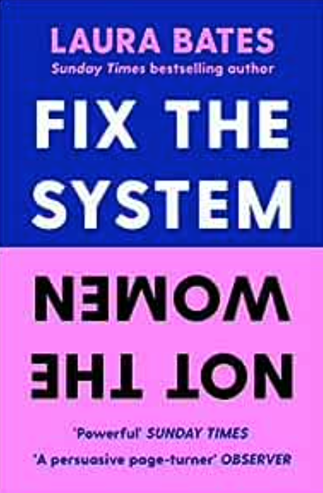
Where’s the issue?
Women are told to be more confident, painting them as lacking self-belief, compared to men who were told how to develop their confidence in specific skills, portraying them as more ‘fixable’.
Developmental feedback for men and women leaders differs despite men and women being rated equally or above on their overall performance.
Men are 19% more likely than women to overestimate their ability and be rewarded for it.
The Leadership Quarterly 2019
https://www.sciencedirect.com/journal/the-leadership-quarterly
Notes:
CONFIDENCE IN OUR OWN ABILITIES CAN BE HELPFUL WITH SOME INTERESTING RESEARCH THAT HIGHLIGHTS RISKS TO ORGANISATIONS WHICH COME FROM BEING OVERCONFIDENT.
IN THE AUTHORITY, GAP, BY MARY-ANN SIEGHART, SHE HIGHLIGHTS THAT OVERCONFIDENCE CAN LEAD TO LAPSES OF JUDGEMENT, DISINCLINATION TO LISTEN TO OTHERS, POOR PERFORMANCE AND TO SUMMARISE, BAD LEADERSHIP.
THERE ARE SOME DIFFERENTIALS ACCORDING TO AGE TOO.
REFERENCE TO LAURA BATES, WHO WROTE A GREAT BOOK, FIX THE SYSTEM, NOT THE WOMEN. SPEAKS TO THE NEED TO ADDRESS INEQUALITIES AT A SYSTEMS NOT JUST INDIVIDUAL LEVEL – TARGETES, QUOTAS, LEADERSHIP DEVELOPMENT SCHEMES AIMED AT WOMEN

Slide 31

Imposter Syndrome
Maya Angelou
“...I've run a game on everybody and they're going to find me out.”
Albert Einstein “The exaggerated esteem in which my lifework is held makes me very ill at ease. I feel compelled to think of myself as an involuntary swindler.”
Notes:
Dealing with Imposter Syndrome:
Define imposter syndrome and its prevalence among high-achieving individuals.
Discuss strategies for recognizing and managing imposter feelings.
Provide practical exercises and resources for building resilience and self-assurance.
These feelings of inadequacy are surprisingly common. A comprehensive 2020 review of 62 studies with over 14,000 participants found that a staggering 56 percent to 82 percent of individuals, across genders, backgrounds, and ages, experienced imposter feelings at some point
Even exceptional individuals struggle and downplay their achievements. For example, Maya Angelou, who after writing 11 books, thought, “...I've run a game on everybody and they're going to find me out.” Albert Einstein was just as critical of his accomplishments and stated, “The exaggerated esteem in which my lifework is held makes me very ill at ease. I feel compelled to think of myself as an involuntary swindler.”

Slide 32
Imposter Syndrome
“I feel like a fraud’
“Others are more skilled than me”
“I don’t deserve my role / status / praise”
“If I don’t get everything right, then I have failed”
”I shouldn’t need to ask for help or support”
Imposter syndrome is linked to feelings of self-doubt and intellectual fraud and can lead to failure (Villwock, Sobin, Koester, & Harris, 2016)
Associated with introversion and trait anxiety and is made worse by overly harsh criticism (Langford & Clance, 1993; Murugesu, 2020).
“Imposter Syndrome isn’t just self-doubt in a spiky suit. It’s the gap between who you see yourself as being and who you think you need to be, to succeed and lead.” Clare Josa
Great webinar:
https://apolitical.co/events/dealing-with-imposter-syndrome-in-the-public-service
Notes:
Not a medical syndrome, not a medical condition
You’ve no doubt heard of imposter syndrome, a concept that originated in a 1978 paper by Dr Pauline Clance and Dr Suzanne Imes called “The imposter phenomenon in high-achieving women: Dynamics and therapeutic interventions.”1 As psychologists at Georgia State University they observed that many of their high-performing female students shared in counseling sessions that they felt their success was undeserved. Now, the term is associated with a fear of being “found out” or discovered as a “fraud” that comes up regardless of how successful and capable you are. BUT THE STUDY ONLY INCLUDED WOMEN
I’m not a fan of labelling yourself as having a syndrome so I prefer to talk about imposter feelings and the wider spectrum of self-doubt within which they sit
Imposter Syndrome happens when someone who is normally confident and successful convinces themselves they actually aren’t good enough, and fears they will be ‘found out’ as a fraud or not as good as they ‘should’ be – despite external evidence that they are doing well.
It triggers stress, fear, anxiety and performance issues, as well as affecting relationships at home.
And having Imposter Syndrome doesn’t mean someone isn’t up to the job - quite the opposite.
I don’t feel like I belong in this role, in this role
You diminish your successes and achievements and diminish successes and achievements
A perfectionist with high standards – often has IS
A psychological state where people express self-doubt about their abilities, skills and accomplishments despite factual evidence to the contrary or other people indicating otherwise.
This can be particularly prevalent among high achievers.
Confidence is situational – it varies according to who we’re with and around. Normal and healthy for this to happen – it’s what we do at these moments that matter:
Recent studies have shown that almost 3 in 5 employees, ranging from all types of sectors and including new hires to senior managers, have experienced what is known as ‘imposter syndrome’.
Everyone has their own sway with – and it shows up in different ways = a group of stakeholders, a particular meeting – a Programme Board
These are some of the sorts of statements that we might expect to hear of someone IS
I lack confidence and others are better than me
Appears at times of transition and newness
We need to…

Slide 33
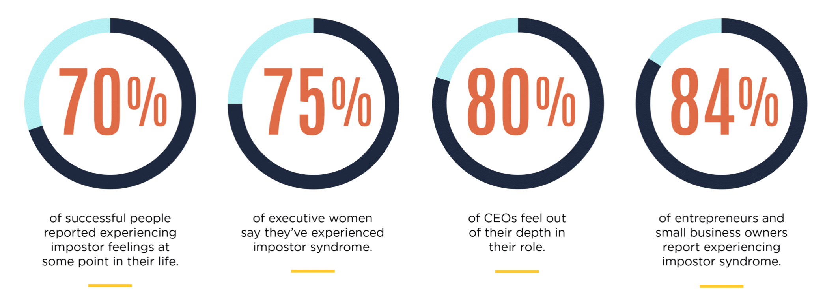
You’re not alone
People who feel like impostors hold themselves to unrealistic, unsustainable standards of competence.
In Dr. Valerie Young's research with hundreds of thousands of people from a wide range of occupations
& at all phases of their careers
https://impostorsyndrome.com/infographics/impostor-syndrome-quiz
https://impostersyndrome.scoreapp.com/?utm_source=diswebsite
What Impact Is Imposter Syndrome Having on You?
The Imposter Institute, Dr Valerie Young, 2022
Notes:
Research from the Imposter Institute
AND There is some recent research that Contrary to the popular understanding, IS is not about self-doubt or lack of confidence
2019 research explores the concept that Self-doubt is about what you can do. Imposter Syndrome is about who you think you are.
SO the pep-talk techniques that help when self-doubt hits, do not when Imposter Syndrome comes out to play.
Links to two quizzes to help you explore- slight preference for Clare JOSA – the second one as its detailed & gives you an action plan, thoughts, emotions and actions

Slide 34
Imposter Syndrome: Impact on Individuals and Organisations
1. Personal:
Hesitation to Share Ideas and Ask Questions
Avoidance of Challenges and Opportunities
Promotion Overlook
Overpersonalization of Constructive Feedback
Procrastination and Task Avoidance
Job Hopping
Excessive Work and Preparation
Physiological Stress and Fatigue
2. Organisational:
Reduced Idea Generation
Missed Opportunities
Shrinking Talent Pool
Increased Absenteeism
Higher Recruitment Costs
https://www.clarejosa.com/2022research/
Notes:
Imposter Syndrome: Impact on Individuals and Organizations
1. Personal Level Impact:
Hesitation to Share Ideas and Ask Questions: Imposter Syndrome often leads individuals to hold back from contributing their insights, fearing they might be inadequate or wrong.
Avoidance of Challenges and Opportunities: Self-doubt prevents people from stepping into new challenges or seizing growth opportunities.
Promotion Overlook: Those affected by Imposter Syndrome may not advocate for themselves, resulting in missed promotions.
Overpersonalization of Constructive Feedback: Individuals may take feedback too personally, hindering growth.
Procrastination and Task Avoidance: Fear of failure can lead to procrastination on critical projects and tasks.
Job Hopping: Imposter Syndrome may cause individuals to switch roles frequently, seeking validation elsewhere.
Excessive Work and Preparation: Overcompensating due to self-doubt can lead to burnout.
Physiological Stress and Fatigue: The constant fear of being exposed as a fraud takes a toll on well-being.
2. Organizational Impact:
Reduced Idea Generation: Imposter Syndrome stifles creativity, resulting in fewer innovative ideas and solutions.
Missed Opportunities: Employees hesitant to take risks may overlook potential business opportunities.
Shrinking Talent Pool: Imposter Syndrome discourages talented individuals from fully participating, limiting the organization’s talent pool.
Increased Absenteeism: Sickness-related absences rise due to stress and anxiety.
Higher Recruitment Costs: Frequent turnover necessitates more recruitment efforts and expenses.

Slide 35
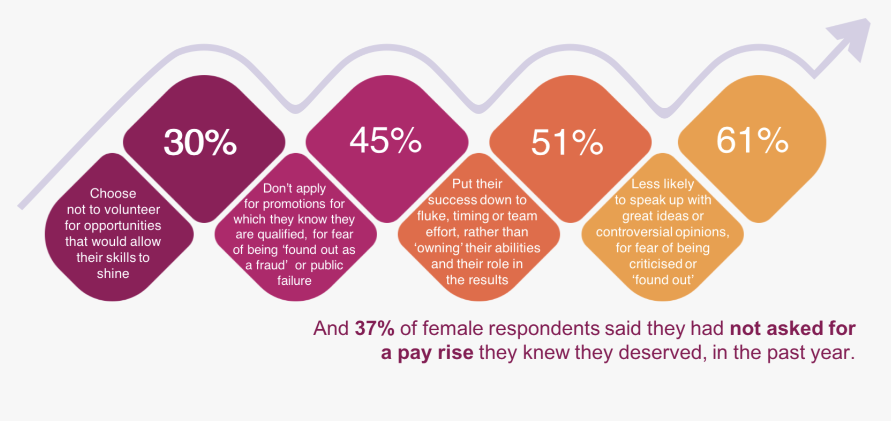
Reported Actions Taken By Women, Caused By The Gender Confidence Gap And Imposter Syndrome
https://www.youtube.com/watch?v=0o-lwOdF8GI
Notes:
Missed opportunities
HOW IMPOSTER SYNDROME HURTS PEOPLE PERFORMANCE PRODUCTIVITY PROFIT
30% of people chose not to volunteer for opportunities that would allow their skill to shine
45% didn’t apply for a promotion that they are qualified for for fear of being found out as a fraud
51% put their success down to luck, timing or team effort rather than their ability
61% less likely to peak up for far of being criticised or found out

Slide 36
Four Ways of ‘Coping’ with Imposter Syndrome
Perfectionism can drive people to set unrealistically high standards and dismiss their achievements as mere luck.
Procrastination involves avoiding tasks by engaging in less important activities, which can be a way to cope with the fear of failure.
Project paralysis is like being frozen in place, unable to start or continue a task due to overwhelming stress.
People-pleasing involves overcommitting, neglecting one’s own needs to gain approval and avoid rejection.
https://impostersyndrome.scoreapp.com/
What Impact Is Imposter Syndrome Having on You?
https://youtu.be/0o-lwOdF8GI?si=FBj-sbJcL9d3Lev7
Notes:
insightful findings on how perfectionism, procrastination, project paralysis, and people-pleasing are interconnected with imposter syndrome and stress responses. These “four Ps” seem to be common coping mechanisms that people use, often unconsciously, to deal with feelings of inadequacy or fear.
Perfectionism can drive people to set unrealistically high standards and dismiss their achievements as mere luck.
Procrastination often involves avoiding tasks by engaging in less important activities, which can be a way to cope with the fear of failure. Over 70% using this approach more than once a day
Project paralysis is like being frozen in place, unable to start or continue a task due to overwhelming stress AVOID TEHN USE STRESS OR ADRELIEN TO PUSH ON THROUGH – EXCESSIVE HOURS, ALLNIGHTERS ETC
Lastly, people-pleasing involves overcommitting and neglecting one’s own needs to gain approval and avoid rejection – TAKE ON SOMEONE ELSE’S PRIORITIES, COMMIT TO THINGS THAT YOU DON’T HAVE A THE CAPACITY TO TAKE
It’s fascinating how these behaviours align with the fight, flight, freeze, and fawn responses of the sympathetic nervous system. This connection highlights how deeply ingrained and automatic these reactions can be – ITS RUNS AT AN UNCOCNSIOUS LEVEL

Slide 37

Feedback
Notes:
Confidence is situational – it varies according to who we’re with and around. Normal and healthy for this to happen – it’s what we do at these moments that matters:

Slide 38
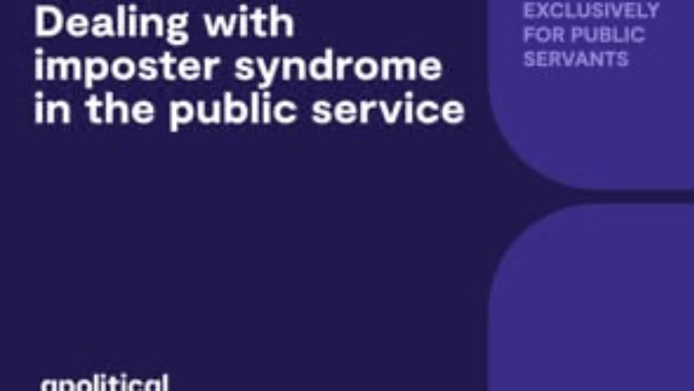
Positive aspects too?…Watch from 15.08 to 21.09
Great webinar: 15.08 to 21.09 finish
https://apolitical.co/events/dealing-with-imposter-syndrome-in-the-public-service
“
Notes:
Let’s hear from Dr Anjhula Mya Singh Bais Chair, International Board, Amnesty International
Look at the positive aspects of IS
15.08 to 21.09 finish
https://apolitical.co/events/dealing-with-imposter-syndrome-in-the-public-service
but I'd argue that all of these things are helpful within limits they serve as a help engage in a sort of early warning detection system if you will and there they are a guide so they're not there to destroy as we're often afraid of stress helps you meet your daily challenges it motivates you to reach your goals you know ultimately making you a smarter happier and healthy person healthier person good stress is vital for a healthy life both good and bad stress result in your body releasing the same hormone such as adrenaline and cortisol that triggered the common signs of stress that we probably all have experience right like butterflies in the stomach racing heart sweaty palms but ultimately what distinguishes good stress from bad is how you react feel or think about the experience so think roller coaster versus a perceived loss an impostor syndrome is kind of like that it's often as you will sort of described as a feeling of being a fraud there was one study in 2020 it was a review of medical studies that showed up to 82% of people experience this syndrome at some point in their life but contrary to popular belief research actually shows that there are hidden benefits to this fear of being found out if you know how to use impostor syndrome to your advantage so one is you have an increased level of self-awareness if you know the things that trigger you you can then consciously choose to behave differently so how does this show up be mindful for example of the situations that trigger your impostor syndrome it could be speaking up at a meeting at a rally is it literally public speaking at all times is it any scenario where you're seen as an expert recognising that you're feeling like an impostor and that is either preventing you from acting or sort of making you feel bad that's actually a good sign because actual impostors don't tend to see themselves as impostors and this heightened self-awareness helps you make smarter decisions since you're more likely to test your gut rather than sort of make a rash decision based on a hunch you learn to develop mental flexibility that's another positive when you question yourself you tend to be more curious you're open to new information people who are more open to shifting their mindset can actually uncover their strengths and weaknesses the perfect combination to find a better solution so how does this show up it's usually the fear of getting things wrong that can lead you especially women to silence yourself and stop you from communicating the valuable ideas that you have So what do you do about this well sometimes the only way to give yourself a voice in a group is to risk the possibility of making a mistake you actually may be surprised to find truly that the others that are receiving your ideas are receiving it in a very different way than how you expect it fellow young global leader of the World Economic Forum with me organisational psychologist Adam grant he accurately describes the art of confident humility which is being assertive about what you know and willing to acknowledge what you don't in grants hypothesis is actually in line with other research so feeling like you're not good enough has it converse impact I've actually making you a better team player so how does this show up you can see this in teamwork committee assignments ministerial portfolios or social event the art of expressing confidence while being humble can actually help you build meaningful relationships with your peers and other notable figures which can pay off in the long run in your career another benefit of impostor syndrome is you are more compassion and empathetic so impostor thoughts makes you more other oriented that means you're being sort of more attuned to other people's perceptions and feelings this is very needed in public service and that makes you more likeable one study actually showed that impostor syndrome correlated with higher empathy skills and generated higher sympathy scores in a lot of cases and how would this show up well politics can be in public service can be a very lonely place or literally every word facial expression engaged and what you can do is you compare the art of confident humility with skills like active listening and then you'll have an easier time be friending people an important stakeholders while you know you're in the political or public service realm and this can help you to combat loneliness improve your mental well-being and genuinely build friendships and networks and the best part and I want to see this to everybody you're not alone chances are other politicians and public service really struggled with the same feeling so if you're unsure where to start thanks to the heightened awareness you be able to reach out to those who are also dealing with the impostor syndrome really that quite honestly it's all of us you be able to deal with it comfortably and then the sky is the limit thank you So it's quite important to recognise the difference between when you do when you don't but certain for people is often a group of stakeholder

Slide 39

Reflections
Notes:
3 Strategies to support people
OPEN UP THE CONVERSATION: “YOU ARE NOT ALONE!”: t the breakthrough came for them once they realised they were not alone.
PROVIDE ACCURATE INFORMATION AND TRAINING: e.g. HR teams and leaders need to know how to spot the early warning signs, along with practical steps they can take to support their team members both short-term and longer-term, if Imposter Syndrome is an issue.
CUT STRESS LEVELS AND TOXIC WORKING ENVIRONMENTS

Slide 40

Moving from Overwhelm to Confidence

Slide 41
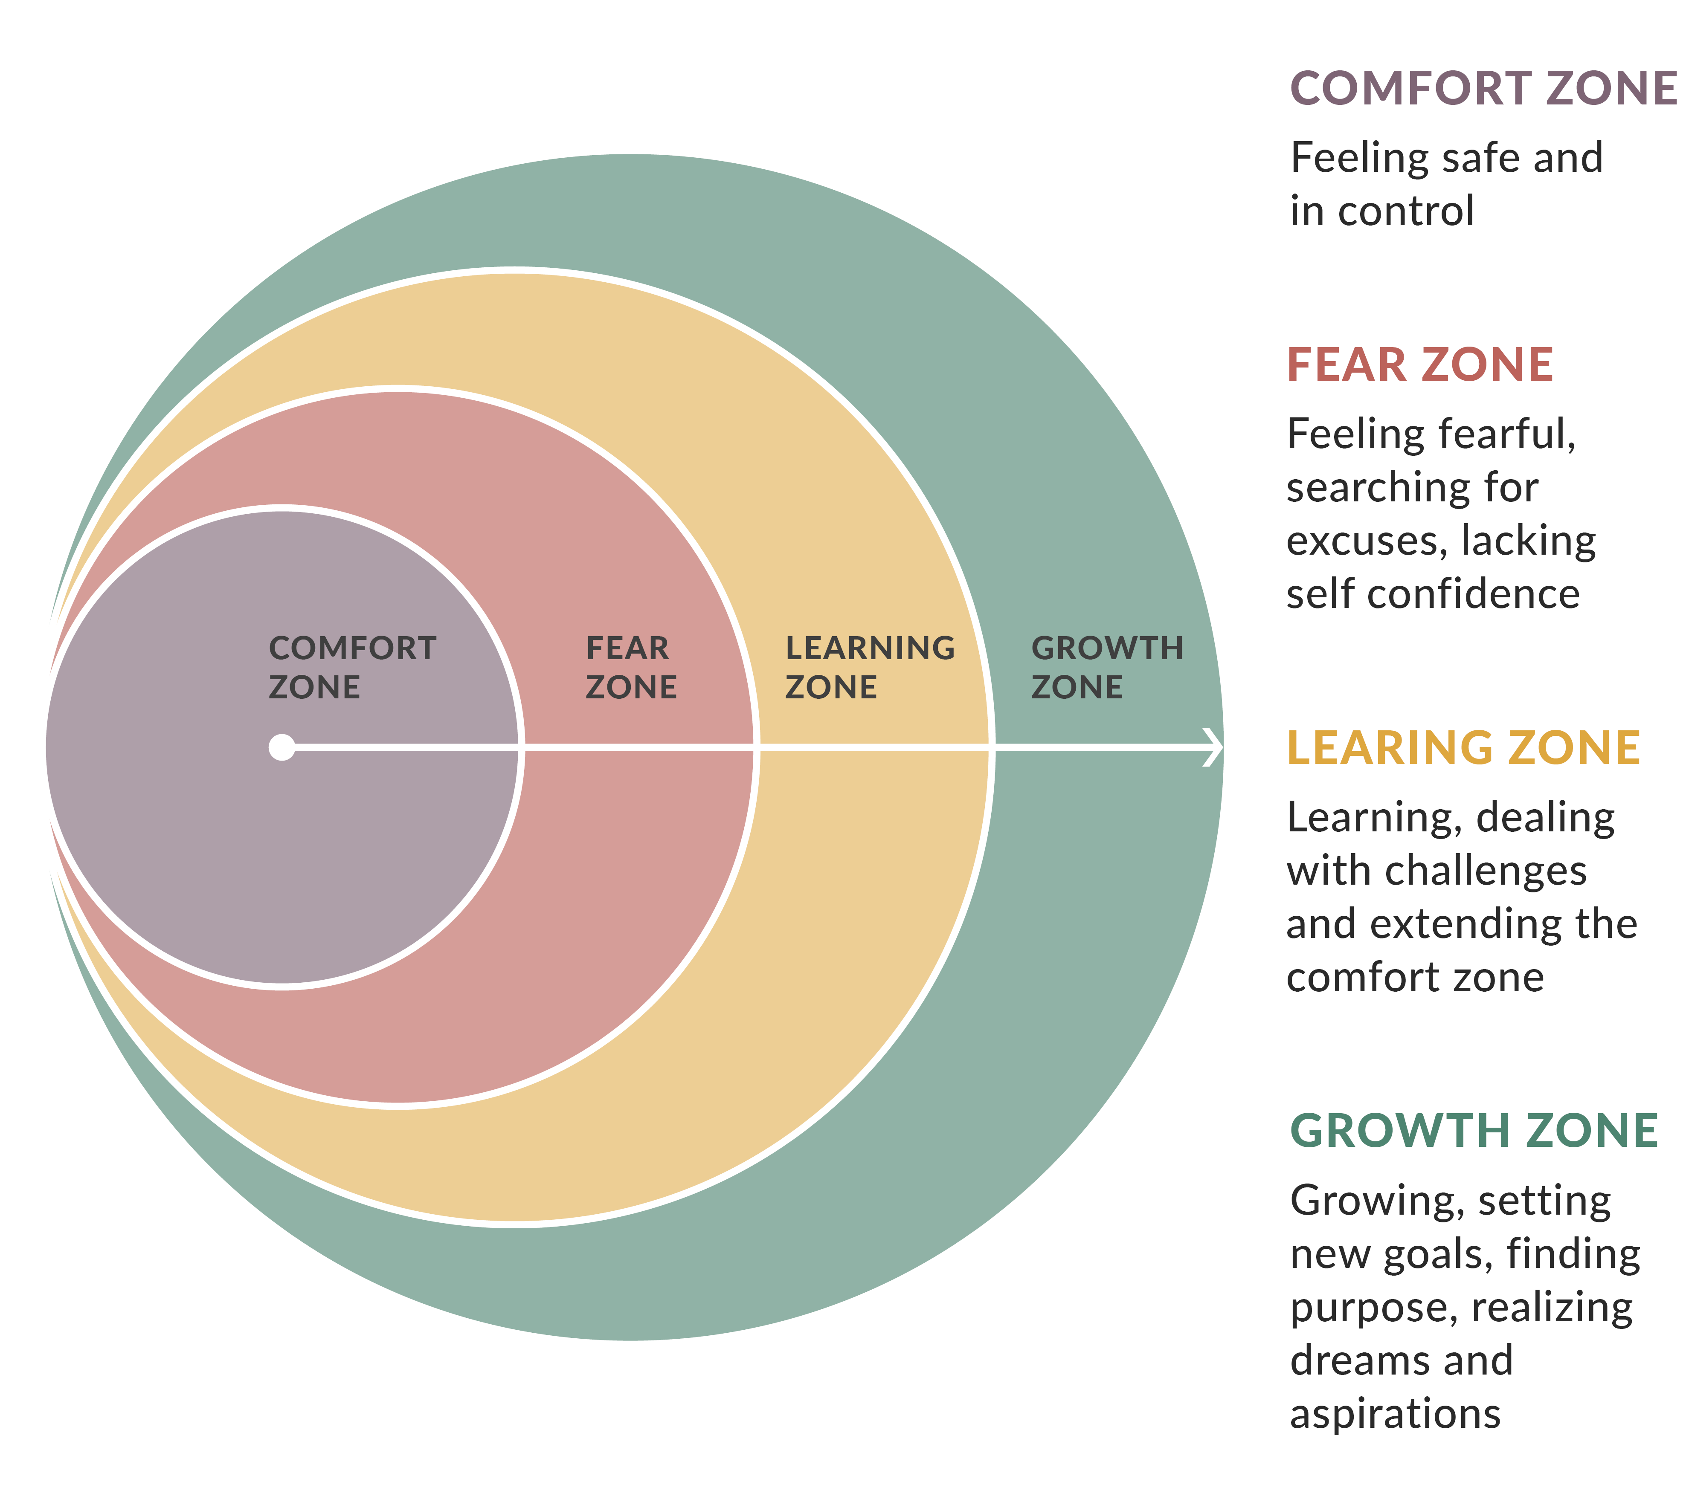
Change is a Shift
Change will trigger a response
Mindset is crucial
HOW we interpret the challenge is key

Slide 42
Life brings the potential to change
A stroke of insight’ 90 second rule.
“When something happens that triggers you, flooded with stress response hormones for 90 secs. Let the 90 seconds pass, or we will react from. Buy time ‘that’s really interesting, let me think about that’.
Your brain doesn’t know the difference between you re-rerunning the story you tell yourself, and it happening in the first place. It casts a great shadow. Gain perspective.
Dr Jill Bolte Taylor: https://www.bbc.co.uk/sounds/play/p0f73q45
Neuroplasticity:
https://youtu.be/ELpfYCZa87g?si=Snlk29X702uteoGo
Notes:
Dr Jill Bolte Taylor is an author and neuroanatomist who used her own stroke to better understand how her brain perceives reality.
WHAT IS NEROPLATICITY

Slide 43
Strategies to Enhance Confidence
Dispute negative thinking
Replace negative self-talk with positive self-talk: Words are powerful.
Build positive emotions
Adopt a growth mindset
Visualize success: performance can help us become more resilient in the workplace to both criticism & change
Resources:
Great Podcast https://ditchingimpostersyndrome.com/ditching-imposter-syndrome-podcast-with-clare-josa/
How do you experience IS?: https://impostersyndrome.scoreapp.com/
Stop Telling Women they Have Imposter Syndrome: https://hbr.org/2021/02/stop-telling-women-they-have-imposter-syndrome
6. Track and measure success
7. Separate inexperience from inability: distinguish inexperience from feeling underserving
8. Dealing with anxiety: Reverse the Rabbit Hole
9. The “What If?” Bias
10. Breath awareness
11. Use assertive body language: adopt a Power Pose (Cuddy 2018)
https://positivepsychology.com/imposter-syndrome-tests-worksheets/
Notes:
1. Dispute negative thinking
Increasing positivity over time reshapes our life by changing how we view ourselves while promoting self-confidence.
Use the Dispute Negative Thinking worksheet to capture negative statements and practice disputing them. As you work through each one, become surer of yourself and more confident in what you can achieve.
2. Build positive emotions
Fredrickson (2010) also suggests building a portfolio of positive emotions.
Use the Build an Emotions Portfolio worksheet.
Write notes for positive emotions (joy, gratitude, serenity, interest, hope, pride, inspiration, awe, love, etc.) based on memories, images, and even songs that come to mind.
Ask yourself a series of questions for each emotion to prompt your thinking, for example, hope:
When have you felt full of optimism and hope?
When have you feared the worst but still believed something good would happen?
When have you found an inventive way to try to create a better future?
Keep the portfolios up to date and create one for each emotion. Engage with them at regular intervals to think “more expansively and compassionately” (Fredrickson, 2010).
3. Adopt a growth mindset
When we adopt a fixed mindset, we don’t handle change well and are less equipped to deal with challenges and criticism. We also tend to stick to what we have been doing even if it isn’t working.
Adopting a growth mindset means we not only cope better but actively look for opportunities for learning and growth (Dweck, 2017). We are less likely to feel like an imposter when we consider ourselves to be a work in progress rather than a finished article.
Move to a growth mindset by completing the Adopt a Growth Mindset worksheet, replacing fixed mindset thinking with growth mindset thinking.
For example:
Avoiding challenge becomes embracing challenge, and being defensive and giving up transforms into persisting despite setbacks.
4. Visualize success
We cannot underestimate the importance of being able to bounce back. When we are criticized, we need to consider others’ thoughts as an opportunity to learn and grow.
Visualizing successful performance can help us become more resilient in the workplace to both criticism and change. Indeed, one of the best ways to rehearse a task, feel more confident, and believe in what we are about to do is to mentally play it through (Clough & Strycharczyk, 2015).
Athletes often visualize what it feels like to step up on to the podium and receive a medal at the end of a successful race.
Try out the Visualize Success worksheet.
The more real the visualization, the better. See yourself as the actor in the scene – not passive but engaged and relaxed.
5. Replace negative self-talk with positive self-talk
Words are powerful. They can bring up images of success or failure and significantly affect how we approach tasks and overcome obstacles and challenges (Clough & Strycharczyk, 2015).
Use the Replace Negative Self-Talk worksheet to identify negative self-talk examples and replace them with their positive equivalent.
When faced with difficult situations, repeat the positive self-talk equivalent to change your mental outlook, for example:
I’m feeling overwhelmed versus I know how to control these feelings; I need to focus on relaxing myself.
6. Track and measure success
We are much better at remembering what went wrong rather than what went well.
And when you feel like an imposter, one of the most difficult things to grasp is the role you have had in your own or others’ successes.
Whether keeping a digital or a handwritten copy, use the Track and Measure Success worksheet to complete a record of all that has gone well, and then review regularly or before a forthcoming challenge.
7. Separate inexperience from inability: An important step to dismantling imposter syndrome is to first distinguish feeling inexperienced from feeling like you are undeserving. “Just because you are starting something for the first time doesn’t mean that you do not belong there, or that you’re incapable of learning,” Jensen says.
8. Dealing with anxiety: Reverse the Rabbit Hole
When we are anxious, the words what if can bring to mind a series of negative images. Use the Reverse the Rabbit Hole Worksheet to identify a plausible positive outcome for every possible negative one.
8. The “What If?” Bias
The “What If?” Bias worksheet is an excellent companion to the above worksheet and helps us to regain a balanced perspective by listing both positive and negative “what ifs.”
9. Breath awareness
Sometimes a simple breath awareness activity is all it takes to ground ourselves and see our situation in context. Try this breathing exercise to reduce stress and anxiety and regain composure when imposter syndrome symptoms begin to derail us.

Slide 44
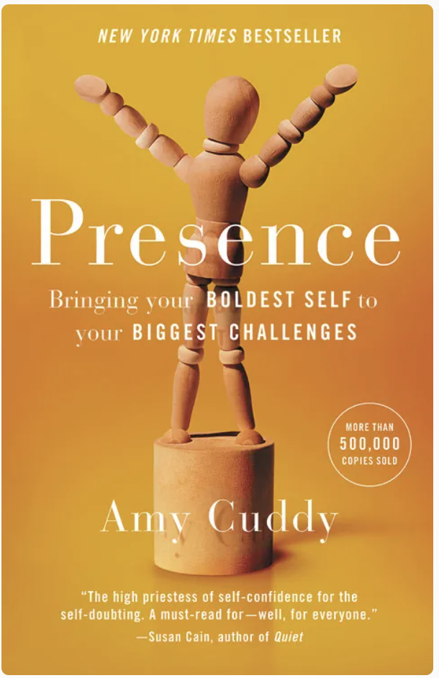
Confidence
Confidence in what you say, especially at work, can come from the posture you adopt.
“When repeated and combined, even small changes to how we speak, stand, and behave can significantly improve our confidence and degree of self-belief. Expansive postures reduce anxiety and help us deal with stress,
People using such postures tend to use fewer negative words, report less fear, and speak more positively” (Cuddy, 2018).
https://www.ted.com/talks/amy_cuddy_your_body_language_may_shape_who_you_are?utm_campaign=tedspread&utm_medium=referral&utm_source=tedcomshare
Notes:
Confidence in what you say, especially at work, can come from the posture you adopt.
She differentiates between powerless poses (slouching, arms tightly crossed, head held low) with powerful ones (standing up straight with arms beside our body like Wonder Woman or Superman, arms open or up high).
Assertive body language – confirmed by her research – is linked to high assertiveness and low anxiety. Both of which can be negatively affected by imposter syndrome.
“Expansive postures also reduce anxiety and help us deal with stress,” says Cuddy. People using such postures tend to use fewer negative words, report less fear, and speak more positively (Cuddy, 2018).
Amy Cuddy wrote Presence – Bringing Your Boldest Self to Your Biggest Challenge (2018), following her incredible success with her TEDx Talk. Based on her research, Cuddy (2018) claims that tweaking our body language can help change our mindset and bring our best selves to our biggest challenges.
Body Language: Our body language can significantly influence how we feel and how others perceive us. By simply changing our posture for two minutes, we can alter our mindset and the course of our interactions.
Power Dynamics: Nonverbal expressions of power and dominance often involve making oneself bigger, stretching out, and taking up space. This is a common behavior across the animal kingdom, including humans.
Impact of Nonverbals: Our nonverbal behavior not only governs how others perceive us, but also how we perceive ourselves. For instance, smiling can make us feel happier.
Gender Differences: In the context of an MBA classroom, it was observed that women tend to make themselves smaller and participate less, which could be attributed to feeling less powerful.
Fake It Till You Make It: The idea of “faking it till you make it” is explored. By pretending to be powerful and adopting the corresponding nonverbal cues, individuals might actually start to feel more powerful.
Body-Mind Connection: The text suggests that just as our minds can change our bodies (e.g., feeling powerful leads to expansive postures), our bodies can also change our minds. This is exemplified by the fact that adopting powerful postures can make individuals feel more powerful.
It’s a scientifically grounded way to align our speech and nonverbal behavior with our beliefs, abilities, and values to produce a synchronized inner state that resonates and connects with others

Slide 45
Growth Mindset
Fixed vs. Growth Mindset: Fixed mindset struggles with change and persists in ineffective methods.
Embracing Growth: Growth mindset seeks learning opportunities and embraces challenges.
Overcoming Imposter Syndrome: Viewing oneself as evolving helps mitigate feelings of fraudulence. we not only cope better but actively look for opportunities for learning and growth (Dweck, 2017).
Transforming Attitudes: Shifting from avoiding challenges to persisting through setbacks.
Fixed: Everything feels set in stone. Thinking is rigid & resistance to change.
Growth: Absorb new knowledge, are open to feedback and adaptable.
Notes:
GROWTH a spouge
FIXED is like being a mountain
Fixed vs. Growth Mindset: Fixed mindset struggles with change and persists in ineffective methods.
Embracing Growth: Growth mindset seeks learning opportunities and embraces challenges.
Overcoming Imposter Syndrome: We are less likely to feel like an imposter when we consider ourselves to be a work in progress rather than a finished article. Viewing oneself as evolving helps mitigate feelings of fraudulence.
Transforming Attitudes: Shifting from avoiding challenges to persisting through setbacks.
When we adopt a fixed mindset, we don’t handle change well and are less equipped to deal with challenges and criticism. We also tend to stick to what we have been doing even if it isn’t working.
Adopting a growth mindset means we not only cope better but actively look for opportunities for learning and growth (Dweck, 2017). We are less likely to feel like an imposter when we consider ourselves to be a work in progress rather than a finished article
Avoiding challenge becomes embracing challenge & being defensive and giving up transforms into persisting despite setbacks.

Slide 46
Mindset Matters
Starting a new job
'I know it all' a need to prove your knowledge
'I don't know that yet, could you please help?' Seeking feedback from a range of people.
When you're a manager
Defensive about feedback, ego-driven
Asking for and acknowledging feedback. Putting the success of your team ahead of your own.
Having a ‘difficult’ conversation
Avoid the conversation, don't listen
Consider opinions. Seeking to understand not just to be understood.
When you're under pressure
Making excuses
Asking for help. Collaborating. Learning from your mistakes. Taking accountability.
Notes:
Let’s look at mindset in action 4 scenarios when mindset really matters
Starting a new job
Fixed: 'I know it all' a need to prove your knowledge Growth: 'I don't know that yet, could you please help?' Seeking feedback from a range of people.
When you're a manager
Fixed: Defensive about feedback, ego-driven Growth: Asking for and acknowledging feedback. Putting the success of your team ahead of your own.
Having a difficult conversation
Fixed: Avoid the conversation, don't listen Growth: Consider opinions. Seeking to understand not just to be understood.
When you're under pressure
Fixed: Blaming, making excuses
Growth: Asking for help. Collaborating. Learning from your mistakes. Taking accountability.
3 TIPS Top tips
Know your mindset triggers
to stay in growth mindset mode as much as possible.
Build your curiosity capability.
Focus on the questions you ask as much as the answers you give.
Find your growth mindset role models. Observe how they learn, adapt and respond to challenge.

Slide 47
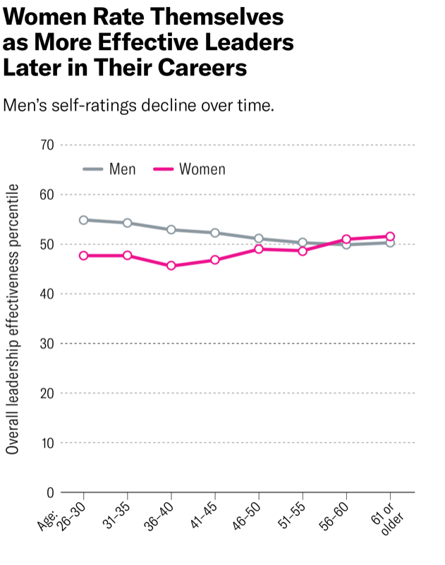
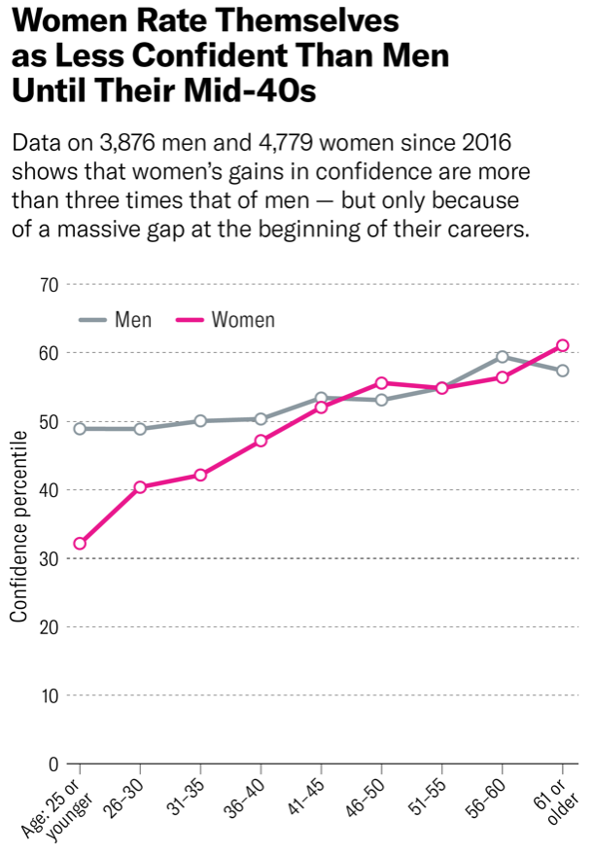
Confidence Changes with Age
https://www.ted.com/talks/brittany_packnett_cunningham_how_to_build_your_confidence_and_spark_it_in_others?language=en
Notes:
IN THE LAST FEW YEARS WE CREATED A SELF-ASSESSMENT THAT MEASURES, AMONG OTHER THINGS, CONFIDENCE. WE’VE BEEN COLLECTING DATA SINCE 2016 (FROM 3,876 MEN AND 4,779 WOMEN SO FAR) ON LEVELS OF CONFIDENCE LEADERS HAVE IN THEMSELVES OVER THEIR CAREERS AND WE SAW SOME INTERESTING TRENDS.
WHEN WE COMPARE CONFIDENCE RATINGS FOR MEN AND WOMEN, WE SEE A LARGE DIFFERENCE IN THOSE UNDER 25. IT’S HIGHLY PROBABLE THAT THOSE WOMEN ARE FAR MORE COMPETENT THAN THEY THINK THEY ARE, WHILE THE MALE LEADERS ARE OVERCONFIDENT AND ASSUMING THEY ARE MORE COMPETENT THAN THEY ARE. AT AGE 40, THE CONFIDENCE RATINGS MERGE. AS PEOPLE AGE THEIR CONFIDENCE GENERALLY INCREASES; SURPRISINGLY, OVER THE AGE OF 60 WE SEE MALE CONFIDENCE DECLINE, WHILE FEMALE CONFIDENCE INCREASES. ACCORDING TO OUR DATA, MEN GAIN JUST 8.5 PERCENTILE POINTS IN CONFIDENCE FROM AGE 25 TO THEIR 60+ YEARS. WOMEN, ON THE OTHER HAND, GAIN 29 PERCENTILE POINTS. ONE NOTE: THIS IS WHAT WE SEE IN OUR DATA THOUGH WE RECOGNIZE THAT THERE ARE STUDIES THAT COME TO DIFFERENT CONCLUSIONS ON WHETHER WOMEN TRULY LACK CONFIDENCE AT EARLY STAGES IN THEIR CAREER.
WE SEE A SIMILAR TREND IN WOMEN’S PERCEPTIONS OF THEIR OVERALL LEADERSHIP EFFECTIVENESS, WITH THEIR RATING RISING AS THEY GET OLDER. THIS DATA IS FROM A STUDY THAT INCLUDES 40,184 MEN AND 22,600 WOMEN AND MEASURES THE OVERALL EFFECTIVENESS RATING OF MALES AND FEMALES ON 49 UNIQUE BEHAVIORS THAT PREDICT A LEADERS EFFECTIVENESS. AGAIN, WOMEN AT YOUNGER AGES RATE THEMSELVES SIGNIFICANTLY LOWER THAN MEN BUT THEIR RATINGS CLIMB — AND EVENTUALLY SUPERSEDE THOSE OF MEN — AS THEY GET OLDER.
THESE FINDINGS ON CONFIDENCE DOVETAIL WITH OTHER RESEARCH THAT SHOWS WOMEN ARE LESS LIKELY TO APPLY FOR JOBS UNLESS THEY ARE CONFIDENT THEY MEET MOST OF THE LISTED QUALIFICATIONS.

Slide 48
BREAK
Notes:
15 minutes

Slide 49
Communications
Leaders inspire positive, incremental change by empowering those around them to work toward common objectives. a leader’s most powerful tool for doing so is communication.
Effective communication is vital to gain trust, aligning efforts to pursue goals and inspiring positive change. When communication is lacking, important information can be misinterpreted, causing relationships to suffer and, ultimately, creating barriers that hinder progress.
Communicating clearly and persuasively gives you impact and influence.
Be clear on the ‘So What? ‘: Get specific about your purpose. If you don’t know precisely what you want from your communication, neither will your audience, all you will get is questions as they seek to clarify.
Know that your audience is not you! Start with your big idea (The So What) and then the technical - decision makers rarely want to know all the technical details before the why
“Confidence is the underlying issue permeating all of leadership presence” https://www.linkedin.com/pulse/secrets-leadership-presence-every-woman-leader-byrne-phd/
Notes:
WHY IS COMMUNICATION IMPORTANT IN LEADERSHIP?
Ask:
THE POWER OF THE SO WHAT? They ask because they want to know why the ideas in your pre- sentation should matter to them and to the business, and they want to know in one simple statement. You might have spent countless hours, days and weeks preparing, but they want a succinct answer that sum- marises everything for them in an instant. And you want the earth to open up and swallow you because you don’t know how to answer this question succinctly.
ASK WHAT ARE EFFECTIVE COMMUNICATIONS?
Women in the Workplace is the largest study on the state of women in corporate America. In 2015, LeanIn.Org and McKinsey & Company launched the study to give companies insights and tools to advance gender diversity in the workplace. Between 2015 and 2022, over 810 companies participated in the study, and more than 400,000 people were surveyed on their workplace experiences. This year, we collected information from 333 participating organizations employing more than 12 million people, surveyed more than 40,000 employees, and conducted interviews with women of diverse identities, including women of color, LGBTQ+ women, and women with disabilities.

Slide 50
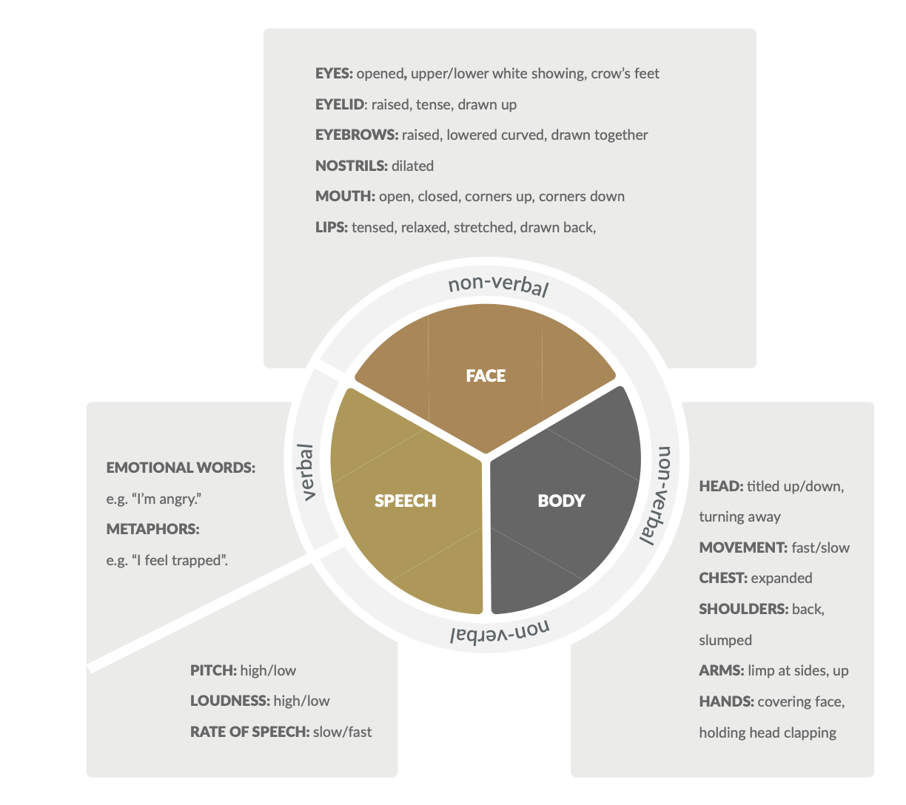
Components of Communications
How to Foster Positive Communication: 9 Effective Techniques (positivepsychology.com)
Notes:
The ability to accurately decipher emotional expressions plays a key role in social interaction (Kilts, Egan, Gideon, Ely, & Hoffman, 2003) as it facilitates appropriate responding and bonding (Isaacowitz et al., 2007).
There are different ways to “read” other people’s emotions, including paying attention to speech (i.e., vocal inflections, tone of voice, word use) and body movements and facial expressions (see the graphic) In the following section, detail.

Slide 51
Communications
“Do you think, maybe, you could possibly read this? If it’s not a problem?”
“I was wondering, actually, does that make sense?”
Do you recognise these phrases in your communications or that of others? What is the impact?
“Women tend to be more tentative in their speech, less declarative,”
Dr Eliot
“Women use nearly three times as many words as men to communicate verbally”
Hira Ali
“Women get interrupted 50% of the time in meetings, and 37% had experienced others taking credit for their ideas “
Tara Mohr How Women Undermine Themselves with words Stephen Furlich, Ph.D., Sex Talk: How Biological Sex Influences Gender Communication Differences Throughout Life’s Stages,
Lise Eliot, Ph.D., Pink Brain, Blue Brain: How Small Differences Grow into Troublesome Gaps — and What We Can Do About It.
Women In The Workplace” report by McKinsey and Lean In, 2022 https://wiw-report.s3.amazonaws.com/Women_in_the_Workplace_2022.pdf
Notes:
WHEN I MET FORMER SECRETARY OF STATE MADELEINE ALBRIGHT IN THE TOILETS AT A CONFERENCE IN EDINBURGH IN MY EARLY CAREER - WHEN ASKED WHAT ADVICE SHE HAD FOR PROFESSIONAL WOMEN, SHE SAID TO ME “LEARN TO INTERRUPT.”
WORDS & PHRASES REINFORCE OR DIMINISH THE IMPORTANCE OF WHAT YOU ACHIEVE. THEY CAN WATER DOWN YOUR AUTHORITY AND LOAD YOUR STATEMENTS WITH AMBIGUITY, GIVING THE IMPRESSION THAT YOU DON’T KNOW WHAT YOU’RE DOING
BY REPLACING MEANINGLESS & UNNECESSARY WORDS, YOU CAN CHANGE THE IMPACT OF THE ENTIRE CONVERSATION & HOW OTHERS PERCEIVE YOU”
DIFFERENCES IN COMMUNICATION BE INFLUENCED BY EITHER BIOLOGY OR SOCIALISATION?
WORDS & PHRASE
OF COURSE, MANY SCIENTISTS SAY THAT COMMUNICATION STYLES AND SKILLS ARE ONLY LEARNED. DR. ELIOT SAYS THAT SOCIAL LEARNING AND MIMICRY DICTATE THOSE STARKLY DIFFERENT MODES OF COMMUNICATION. FROM THIS PERSPECTIVE, TRADITIONALLY “MALE” AND “FEMALE” TENDENCIES TOWARD SOCIAL INTERACTION ARE NOT AT ALL HARDWIRED, INSTEAD THEY’RE “LEARNED FROM THE CORRESPONDING SAME-SEX MODELS BEGINNING FROM BABIES’ EARLIEST DAYS.” SHE ARGUES, “NATURE AND NURTURE ARE NOT EQUALLY RESPONSIBLE FOR GENDERED COMMUNICATION DIFFERENCES. NATURE PLAYS ALMOST NO ROLE, WITH THE MINOR EXCEPTION OF VOCAL PITCH (HIGHER OR LOWER VOICE).”. 1. DO “MALE” AND “FEMALE” BRAIN STRUCTURES MAKE US COMMUNICATE DIFFERENTLY? POSSIBLY DR. FURLICH, PEOPLE BORN BIOLOGICALLY AS FEMALES “HAVE A MUCH MORE INTEGRATED BRAIN” — WHICH MEANS MORE CONNECTIONS ACROSS BOTH HEMISPHERES OF THE BRAIN. ON THE OTHER HAND, MEN HAVE MORE CONNECTIONS WITHIN EACH HEMISPHERE.
OTHER GENDERS?
DR. ELIOT ARGUES THAT HER RESEARCH STRONGLY SUPPORTS THE VALIDITY OF GENDER FLUIDITY: “FROM MY PERSPECTIVE, THE DISCOVERY THAT MALE AND FEMALE BRAINS HARDLY DIFFER AT ALL IN STRUCTURE OR CONNECTIVITY (BEYOND 10 PERCENT SIZE DIFFERENCE, WHICH IS PROPORTIONAL TO BODY SIZE) HAS REINFORCED THE IDEA THAT GENDER IS A SPECTRUM AND VERY FLUID.” ALONG WITH NEUROSCIENCE, SHE ARGUES THAT “THE GROWING PREVALENCE OF TRANS, NON-BINARY, GENDER FLUID, GENDERQUEER, ANDROGYNOUS, AND OTHER POPULATIONS HAS DEBUNKED THE IDEA THAT GENDER IS HARDWIRED IN BRAIN STRUCTURE.”
ACCORDING TO A REPORT FROM THE ECONOMIST INTELLIGENCE UNIT (PDF), POOR COMMUNICATION CAN LEAD TO LOW MORALE, MISSED PERFORMANCE GOALS, AND EVEN LOST SALES. A SEPARATE STUDY FOUND THAT INADEQUATE COMMUNICATION CAN COST LARGE COMPANIES AN AVERAGE OF $64.2 MILLION PER YEAR, WHILE SMALLER ORGANIZATIONS ARE AT RISK OF LOSING $420,000 ANNUALLY.
BUT EFFECTIVE COMMUNICATION IMPACTS MORE THAN JUST THE BOTTOM LINE. FOR LEADERS, IT’S WHAT ENABLES THEM TO RALLY THEIR TEAM AROUND A SHARED VISION, EMPOWER EMPLOYEES, BUILD TRUST, AND SUCCESSFULLY NAVIGATE ORGANIZATIONAL CHANGE.
HTTPS://KATIECOURIC.COM/LIFESTYLE/RELATIONSHIPS/GENDER-DIFFERENCES-IN-COMMUNICATION-STYLE/
HTTPS://WWW.TARAMOHR.COM/COMMUNICATION-TIPS/8-WAYS-WOMEN-UNDERMINE-THEMSELVES-WITH-THEIR-WORDS/
HERE ARE EIGHT WAYS YOU MIGHT BE UNDERMINING YOURSELF WITH YOUR WORDS–AND EIGHT WAYS TO STOP:
1. DROP THE “JUST:” “I’M JUST WONDERING …” “I JUST THINK …” “I JUST WANT TO ADD …” “JUST” DEMEANS WHAT YOU HAVE TO SAY. “JUST” SHRINKS YOUR POWER. IT’S TIME TO SAY GOODBYE TO THE JUSTS.
2. WHILE YOU ARE AT IT, DROP THE “ACTUALLY.” “I ACTUALLY HAVE A QUESTION.” ” I ACTUALLY WANT TO ADD SOMETHING.” “ACTUALLY” COMMUNICATES A SENSE OF SURPRISE THAT YOU HAVE SOMETHING TO SAY. OF COURSE YOU WANT TO ADD SOMETHING. OF COURSE YOU HAVE QUESTIONS. THERE’S NOTHING SURPRISING ABOUT IT.
3. DON’T TELL US WHY WHAT YOU ARE ABOUT TO SAY IS LIKELY TO BE WRONG. WE ARE STILL STARTING SENTENCES WITH, “I HAVEN’T RESEARCHED THIS MUCH BUT …” “I’M JUST THINKING OFF THE TOP OF MY HEAD BUT …” “YOU’VE CLEARLY BEEN STUDYING THIS LONGER THAN I HAVE, BUT …”
WE DO THIS FOR LOTS OF REASONS. WE DON’T WANT TO APPEAR ARROGANT. WE AREN’T TOTALLY SURE ABOUT WHAT WE ARE SAYING. OR WE FEAR BEING WRONG, AND SO WE BUFFER THE STING OF A CRITICAL RESPONSE BY SAYING UP FRONT, “I’M NOT TOTALLY STANDING BEHIND WHAT I’M ABOUT TO SAY, BUT …” THEN, NO ONE HAS THE CHANCE TO SAY BACK, “WELL, I KNOW YOU STRONGLY BELIEVE THIS, BUT I ENTIRELY DISAGREE.”
NO MATTER WHAT THE REASON, DOING THIS TAKES AWAY FROM THE POWER OF YOUR VOICE. TIME TO CHANGE THE HABIT.
4. DON’T TELL US YOU ARE GOING TO “JUST TAKE A MINUTE” TO SAY SOMETHING. OFTEN, IN PRESENTATIONS OR MEETINGS, I HEAR WOMEN SAY, “I’D LIKE TO ASK YOU TO TAKE JUST A MINUTE TO CONSIDER THIS IDEA” OR “NOW, I’M GOING TO TAKE JUST A FEW MINUTES TO TELL YOU ABOUT OUR PRODUCT.” THINK ABOUT HOW MUCH STRONGER IT SOUNDS TO SIMPLY SAY, “I’D LIKE TO TELL YOU ABOUT OUR PRODUCT.”
GO AHEAD AND ONLY TAKE A MINUTE, IF THAT’S APPROPRIATE, BUT SKIP USING THE PHRASE “JUST A MINUTE” IN A TALK OR PRESENTATION. IT SOUNDS APOLOGETIC AND IMPLIES THAT YOU DON’T THINK WHAT YOU ARE ABOUT TO SAY IS WORTHY OF TIME AND ATTENTION.
5. DON’T MAKE YOUR SENTENCES SOUND LIKE QUESTIONS. WOMEN OFTEN RAISE THE PITCH OF THEIR VOICE AT THE END OF A SENTENCE, MAKING IT SOUND LIKE A QUESTION. LISTEN TO YOUR OWN LANGUAGE AND THAT OF WOMEN AROUND YOU, AND YOU ARE LIKELY TO NOTICE THIS EVERYWHERE. UNSURPRISINGLY, SPEAKING A STATEMENT LIKE A QUESTION DIMINISHES ITS POWER. MAKE STATEMENTS SOUND LIKE STATEMENTS; DROP THE TONE LOWER AT THE END.
6. DON’T SUBSTITUTE A QUESTION FOR A STATEMENT. YOU MIGHT THINK YOU ARE “SUGGESTING” INCREASING THE MARKETING BUDGET BY ASKING, “WHAT ABOUT INCREASING THE MARKETING BUDGET?” IN A MEETING, BUT YOUR COLLEAGUES AREN’T LIKELY TO HEAR AN OPINION (AND CERTAINLY NOT A WELL THOUGHT-OUT OPINION) IN YOUR QUESTION. WHEN YOU HAVE SOMETHING TO SAY, DON’T COUCH IT IN A QUESTION.
SOMETIMES, OF COURSE, THERE ARE STRATEGIC REASONS TO USE A QUESTION RATHER THAN A STATEMENT: TO GENTLY INTRODUCE AN IDEA TO A GROUP THAT IS LIKELY TO BE RESISTANT TO IT, FOR EXAMPLE. BUT WOMEN OFTEN TURN TO QUESTIONS RATHER THAN STATEMENTS BECAUSE WE ARE AVOIDING CONFLICT, AVOIDING VISIBILITY, AVOIDING CLAIMING POWER. WE USE QUESTIONS BECAUSE WE HAVE OLD STORIES ABOUT IT BEING DANGEROUS OR INAPPROPRIATE TO STATE OUR IDEAS DEFINITIVELY, AND WE CAN’T SEE HOW SHARING OUR PERSPECTIVE BOLDLY AND DIRECTLY COULD ACTUALLY HUGELY BENEFIT OUR CAREERS. TIME TO LET THE OLD STORIES GO.
7. PUNCTUATE AND PAUSE. IMAGINE SITTING ACROSS A TABLE LISTENING TO A WOMAN SHARE THIS: “WE ARE WORKING HARD ON THIS, BECAUSE WE WANT TO GET THE BUSINESS UP IN RUNNING BY 2012, SPECIFICALLY APRIL 2012, WHICH IS THE TARGET DATE, AND WE ARE VERY OPTIMISTIC THAT WITH THE RIGHT FINANCING WE CAN GET THERE, AND SO THAT IS WHY I’VE BEEN APPROACHING DIFFERENT INVESTORS EVERY DAY…”

Slide 52
Perceptions of Female Communications
Strength
Active listening skills
Aptitude for understanding nonverbal cues
Displaying empathy
Weakness
Meander – take time to get to the point
Act overly emotional when communicating
Not being authoritative enough
STAND OUT: How to Build Your Leadership Presence, Dr Carol Goman, 2021
Notes:
DR CAROL GORMAN IN HER BOOK STAND OUT, HOW TO BUILD LEADERSHIP PRESENCE LOOKED AT COMMUNICATION DIFFERENCES ACROSS GENDERS. LEADERSHIP PRESENCE DOESN'T COME WITH A TITLE OR PROMOTION - GOOD LEADERS DEVELOP PRESENCE OVER TIME.
STRENGTHS OF FEMALE COMMUNICATION ARE LISTENING SKILLS, AN APTITUDE FOR UNDERSTANDING NONVERBAL CUES AND DISPLAYING EMPATHY.
THE STRENGTHS OF MALE COMMUNICATION ARE THE ABILITY TO COMMAND PRESENCE AND/OR POWER AND TO CONVEY MESSAGES STRAIGHTFORWARDLY.
WEAKNESSES THROUGH TENDENCIES TO MEANDER OR ACT OVERLY EMOTIONAL WHEN COMMUNICATING, AS WELL AS NOT BEING AUTHORITATIVE ENOUGH, WHEREAS MEN HAD WEAKNESSES THROUGH TENDENCIES TO BE TOO STRAIGHTFORWARD OR CONFIDENT IN THEIR PERSPECTIVE AND INSENSITIVE TO PEERS.

Slide 53

Persuasive Communication
Any message that is intended to shape, reinforce, or change the responses of another or others.
Such responses are modified by messages that appeal to the target’s reason and emotions
The Three C’s
Be concise
Be credible
Be compelling
The “What, So What, Now What” Framework
The structure is comprised of three simple questions:
What: Describe and define the facts, situation, product, position, etc.
So What: Discuss the implications or importance for the audience. In other words, the relevance to them.
Now What: Outline the call-to-action or next steps, such as taking questions or setting up a next meeting.
Matt Abrahams
https://youtu.be/A1siJ0AnI3A?si=fYH2k4M5ZTq0vLUf
Communication for Governance & Accountability Program (CommGAP)
WORLD BANK https://assets.publishing.service.gov.uk/media/57a08b6d40f0b64974000b44/Persuasionweb.pdf
Notes:
The Value of Structure in Communication
Much like the Swiss Army Knife, known for its versatility and reliability, this structure is flexible and can be used in many different communication situations
Persuasive communication can be defined as any message that is intended to shape reinforce or to change the responses of another person or people
Can be targeted in 3 ways it can impact by changing cognition, attitudes and behaviour. For example, cognition changing peoples beliefs about an issue. Secondly, changing their attitudes and thirdly behaviour what it is people do a stock doing.
World bank
Ask what type of communication might be considered ineffective or unpersuasive?
The Value of Structure in Communication
A structure provides a roadmap, a logical connection of ideas that guides both the communicator and the listener. Think of it as a carefully crafted story or a well-designed recipe. And the benefits of using one are many:
Clarity: A structure eliminates ambiguity, ensuring that your message is straightforward and easy to understand and follow.
Retention: Ideas presented in a structured manner are more likely to be remembered, making your communication more impactful. Our brains are actually designed to encode and remember structured information.
Persuasion: A logical structure builds your case point by point, facilitating persuasion by guiding your audience through a reasoned argument.
Efficiency: Structure saves time and mental energy, simplifying complex ideas into digestible, actionable points.
Reduced anxiety: Having a predefined structure can significantly lessen communication anxiety, as you already know how to convey what you need to say and you are less likely to forget your content.

Slide 54

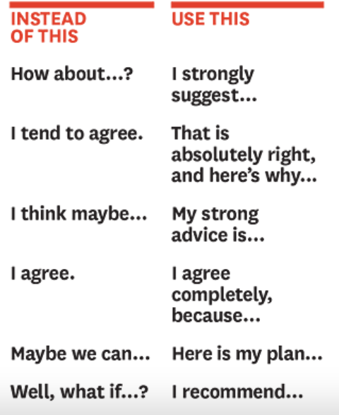
Ways you might be undermining yourself with your words & Ways to stop
Drop the “just”.
Drop the “actually.
Don’t tell us why what you are about to say is likely
wrong.
Don’t tell us you will “just take a minute” to say
something.
Don’t make your sentences sound like questions.
Don’t substitute a question for a statement.
Punctuate and Pause.
Keep being yourself.
https://www.managers.org.uk/knowledge-and-insights/article/this-may-be-a-stupid-idea-but-how-to-stop-underselling-yourself/?utm_source=ManagementDirect&utm_medium=web&utm_campaign=Insight_referrals
https://www.linkedin.com/pulse/secrets-leadership-presence-every-woman-leader-byrne-phd/
https://hbr.org/2014/06/women-find-your-voice
Notes:
ASK FOR FEEDBACK – SUMMARY OF THE ARTICLE TARA MOHR
HTTPS://WWW.TARAMOHR.COM/COMMUNICATION-TIPS/8-WAYS-WOMEN-UNDERMINE-THEMSELVES-WITH-THEIR-WORDS/
AND IDEAS ABOUT HOW TO REFRAME – FROM HARVARD BUSINESS REVIEW
DROP THE “JUST:” “I’M JUST WONDERING …” “I JUST THINK …” “I JUST WANT TO ADD …” “JUST” DEMEANS WHAT YOU HAVE TO SAY. “JUST” SHRINKS YOUR POWER. IT’S TIME TO SAY GOODBYE TO THE JUSTS.
WHILE YOU ARE AT IT, DROP THE “ACTUALLY.” “I ACTUALLY HAVE A QUESTION.” ” I ACTUALLY WANT TO ADD SOMETHING.” “ACTUALLY” COMMUNICATES A SENSE OF SURPRISE THAT YOU HAVE SOMETHING TO SAY. OF COURSE, YOU WANT TO ADD SOMETHING. OF COURSE, YOU HAVE QUESTIONS. NOTHING IS SURPRISING ABOUT IT.
DON’T TELL US WHY WHAT YOU ARE ABOUT TO SAY IS LIKELY WRONG. WE ARE STILL STARTING SENTENCES WITH, “I HAVEN’T RESEARCHED THIS MUCH BUT …” “I’M JUST THINKING OFF THE TOP OF MY HEAD BUT …” “YOU’VE BEEN STUDYING THIS LONGER THAN I HAVE, BUT …” WE DO THIS FOR LOTS OF REASONS. WE DON’T WANT TO APPEAR ARROGANT. WE AREN’T SURE ABOUT WHAT WE ARE SAYING. OR WE FEAR BEING WRONG, AND SO WE BUFFER THE STING OF A CRITICAL RESPONSE BY SAYING UP FRONT, “I’M NOT TOTALLY STANDING BEHIND WHAT I’M ABOUT TO SAY, BUT …” THEN, NO ONE CAN SAY BACK, “WELL, I KNOW YOU STRONGLY BELIEVE THIS, BUT I ENTIRELY DISAGREE.” NO MATTER THE REASON, DOING THIS TAKES AWAY FROM THE POWER OF YOUR VOICE. TIME TO CHANGE THE HABIT.
DON’T TELL US YOU WILL “JUST TAKE A MINUTE” TO SAY SOMETHING. IN PRESENTATIONS OR MEETINGS, I OFTEN HEAR WOMEN SAY, “I’D LIKE TO ASK YOU TO TAKE JUST A MINUTE TO CONSIDER THIS IDEA” OR “NOW, I’M GOING TO TAKE JUST A FEW MINUTES TO TELL YOU ABOUT OUR PRODUCT.” CONSIDER HOW MUCH STRONGER IT SOUNDS TO SAY, “I’D LIKE TO TELL YOU ABOUT OUR PRODUCT.” GO AHEAD AND TAKE ONLY A MINUTE, IF APPROPRIATE, BUT SKIP USING THE PHRASE “JUST A MINUTE” IN A TALK OR PRESENTATION. IT SOUNDS APOLOGETIC AND IMPLIES THAT YOU DON’T THINK WHAT YOU ARE ABOUT TO SAY IS WORTHY OF TIME AND ATTENTION.
DON’T MAKE YOUR SENTENCES SOUND LIKE QUESTIONS. WOMEN OFTEN RAISE THE PITCH OF THEIR VOICE AT THE END OF A SENTENCE, MAKING IT SOUND LIKE A QUESTION. LISTEN TO YOUR LANGUAGE AND THAT OF WOMEN AROUND YOU; YOU WILL LIKELY NOTICE THIS EVERYWHERE. UNSURPRISINGLY, SPEAKING A STATEMENT LIKE A QUESTION DIMINISHES ITS POWER. MAKE STATEMENTS SOUND LIKE STATEMENTS; DROP THE TONE LOWER AT THE END.
DON’T SUBSTITUTE A QUESTION FOR A STATEMENT. YOU MIGHT THINK YOU ARE “SUGGESTING” INCREASING THE MARKETING BUDGET BY ASKING, “WHAT ABOUT INCREASING THE MARKETING BUDGET?” IN A MEETING. STILL, YOUR COLLEAGUES AREN’T LIKELY TO HEAR AN OPINION (AND CERTAINLY NOT A WELL-THOUGHT-OUT OPINION) IN YOUR QUESTION. DON’T COUCH IT IN A QUESTION WHEN YOU HAVE SOMETHING TO SAY. SOMETIMES, OF COURSE, THERE ARE STRATEGIC REASONS TO USE A QUESTION RATHER THAN A STATEMENT: GENTLY INTRODUCING AN IDEA TO A GROUP LIKELY TO RESIST IT, FOR EXAMPLE. BUT WOMEN OFTEN TURN TO QUESTIONS RATHER THAN STATEMENTS BECAUSE WE ARE AVOIDING CONFLICT, AVOIDING VISIBILITY, AND AVOIDING CLAIMING POWER. WE USE QUESTIONS BECAUSE WE HAVE OLD STORIES ABOUT IT BEING DANGEROUS OR INAPPROPRIATE TO STATE OUR IDEAS DEFINITIVELY, AND WE CAN’T SEE HOW SHARING OUR PERSPECTIVE BOLDLY AND DIRECTLY COULD HUGELY BENEFIT OUR CAREERS. TIME TO LET THE OLD STORIES GO.
PUNCTUATE AND PAUSE. IMAGINE SITTING ACROSS A TABLE AND LISTENING TO A WOMAN SHARE THIS: “WE ARE WORKING HARD ON THIS, BECAUSE WE WANT TO GET THE BUSINESS UP IN THE RUNNING BY 2012, SPECIFICALLY APRIL 2012, WHICH IS THE TARGET DATE, AND WE ARE VERY OPTIMISTIC THAT WITH THE RIGHT FINANCING, WE CAN GET THERE, AND SO THAT IS WHY I’VE BEEN APPROACHING DIFFERENT INVESTORS EVERY DAY…”
KEEP BEING YOURSELF. WOMEN HAVE UNIQUE WAYS OF COMMUNICATING — WAYS THAT TEND TO BE MORE COLLABORATIVE, CONSENSUS-BUILDING, AND INVITING. THESE NEW HABITS ARE NOT ABOUT ADOPTING AN AUTHORITATIVE COMMUNICATION STYLE THAT DOESN’T SIT RIGHT WITH YOU IN YOUR HEART; THEY ARE ABOUT GIVING UP THE SELF-DIMINISHING PATTERNS THAT STEM FROM BEING AFRAID OF POWER OR FROM BELIEVING WHAT OUR INNER CRITICS HAVE TO SAY, AND AS A RESULT, SHARING OUR IDEAS TENTATIVELY.

Slide 55
Recognise any of these listening habits?
The advice giver
The faker
The rebuttal maker
The interrupter
The intellectual or logical listener
The dominating speaker
May jump in too quickly before the speaker has had the chance to articulate their thoughts
They nod but they aren’t really listening
Listens but only to find a rebuttal
They can’t wait for you to finish
Interested in what’s behind the message & are judging based on what they already know
Uses the message only to get their point across
© MyPD 2022
Notes:
LISTEN IS AN SILENCE

Slide 56

How to improve listening skills
Know your instinctive responses and practice more active listening
Pay attention: non-verbal, verbal and allowing people to finish, being aware of body language
Check to understand paraphrasing, summarising, and reflecting on the words
Allow for silence: don’t rush in or interrupt. Allow reflection to take place
Encourage exploration: “Tell me more about that.” Make it clear that you want to support the person in reflecting and understanding
Notes:
QUESTIONS YOU COULD ASK INCLUDE
LET ME CONFIRM...
CAN I MAKE SURE I UNDERSTAND WHAT YOU’VE SAID..?
CAN I JUST CHECK?
SUMMARISING:
CAN I SUMMARISE WHAT YOU’VE SAID?
I THINK YOU SAID...
CHECKING:
IS THAT RIGHT?
HAVE I UNDERSTOOD YOU CORRECTLY?

Slide 57
Feedback

Slide 58
Negotiation
‘To confer or discuss with a view to reaching agreement’.
Women report experiencing a great deal of apprehension about negotiation how much more than men?
When you think about negotiating an outcome for yourself, what words would you use to describe it?
Are there differences in how men and women are perceived when they negotiate?
Notes:
ASK the group questions
2. ADD WORDS TO EXCITING, FUN, LIKE WINNING A GAME; SCARY, LIKE GOING TO THE DENTIST, INSECURE, NERVOUS, POWERFUL, ASSERTIVE
3. A YES OR NO
86% of women expressed strong negative feelings about negotiating (e.g., "makes me feel insecure, nervous");
14% had positive emotion (e.g., "makes me feel powerful, assertive")

Slide 59

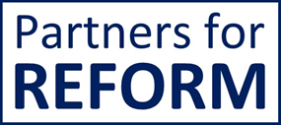
The Barriers Women Face When Negotiating
Stereotypes & biases:
  Males & females were less interested in working with women who attempted to negotiate a better salary than men who tried to negotiate a higher salary.
  People are more likely to lie to female negotiators than to male negotiators. Women were lied to more often because participants viewed them as less competent than men and thus less likely to question their lies.
  Both men and women were more likely to give male negotiators preferential treatment by disclosing hidden interests.
  Research by Harvard Business School, Carnegie Mellon University, University of Tulane, University of Pennsylvania https://www.pon.harvard.edu/daily/leadership-skills-daily/women-and-negotiation-leveling-the-playing-field/
Notes:
SKIP OVER TELL THEM TO READ
HERE ARE SOME CHALLENGES FACING WOMEN NEGOTIATORS
NEGOTIATING TIPS FOR WOMEN NEGOTIATORS TO ACHIEVE RESULTS AT THE NEGOTIATION TABLE
BY KATIE SHONK — ON JUNE 1ST, 2023 / LEADERSHIP SKILLS
BY NOW, MOST OF US ARE AWARE THAT WOMEN APPEAR TO FACE SIGNIFICANT HURDLES IN NEGOTIATION (SEE ALSO, NEGOTIATION EXAMPLES AND WOMEN NEGOTIATORS: BARRIERS TO THE NEGOTIATION TABLE). HERE ARE SOME NEGOTIATING SKILLS AND NEGOTIATION TACTICS FOR WOMEN NEGOTIATORS TO LEVEL THE PLAYING FIELD IN NEGOTIATION SCENARIOS.
CLAIM YOUR FREE COPY: REAL LEADERS NEGOTIATE
IF YOU ASPIRE TO BE A GREAT LEADER, NOT JUST A BOSS, START HERE: DOWNLOAD OUR FREE SPECIAL REPORT, REAL LEADERS NEGOTIATE: UNDERSTANDING THE DIFFERENCE BETWEEN LEADERSHIP AND MANAGEMENT, FROM HARVARD LAW SCHOOL.
THE BARRIERS WOMEN NEGOTIATORS FACE
TO BEGIN, WOMEN ARE PENALIZED FOR NEGOTIATING ON THEIR OWN BEHALF. IN THEIR RESEARCH, PROFESSOR HANNAH RILEY BOWLES OF HARVARD BUSINESS SCHOOL, PROFESSOR LINDA BABCOCK OF CARNEGIE MELLON UNIVERSITY, AND PROFESSOR LEI LAI OF TULANE UNIVERSITY FOUND THAT BOTH MALE AND FEMALE STUDY PARTICIPANTS WERE LESS INTERESTED IN WORKING WITH WOMEN WHO ATTEMPTED TO NEGOTIATE A BETTER SALARY THAN THEY WERE WITH MEN WHO TRIED TO NEGOTIATE A HIGHER SALARY. THE FACT THAT WOMEN NEGOTIATORS ARE GENERALLY LESS LIKELY TO INITIATE SALARY NEGOTIATIONS THAN MEN APPEARS TO BE DUE AT LEAST IN PART TO WOMEN’S AWARENESS THAT NEGOTIATING COULD TRIGGER THIS TYPE OF SOCIAL BACKLASH AT THE OFFICE.
PEOPLE ARE ALSO MORE LIKELY TO LIE TO FEMALE NEGOTIATORS THAN TO MALE NEGOTIATORS, RESEARCHERS LAURA J. KRAY AND ALEX B. VAN ZANT OF THE UNIVERSITY OF CALIFORNIA, BERKELEY, AND JESSICA A. KENNEDY OF THE UNIVERSITY OF PENNSYLVANIA FOUND IN A NEW STUDY. WOMEN WERE LIED TO MORE OFTEN BECAUSE PARTICIPANTS VIEWED THEM AS LESS COMPETENT THAN MEN AND THUS LESS LIKELY TO QUESTION THEIR LIES. BOTH MEN AND WOMEN ALSO WERE MORE LIKELY TO GIVE MALE NEGOTIATORS PREFERENTIAL TREATMENT BY DISCLOSING HIDDEN INTERESTS.
SUCH STEREOTYPES AND BIASED TREATMENT CAN SIGNIFICANTLY HINDER WOMEN’S NEGOTIATED OUTCOMES, PUTTING THEM AT AN UNFAIR ADVANTAGE. THE QUESTION IS, HOW CAN WE REMEDY THIS STATE OF AFFAIRS? EXPERTS HAVE ADVOCATED A NUMBER OF APPROACHES.

Slide 60
Best Alternative to Negotiated Agreement (BATNA)
A course of action you’d take if a deal is not possible (i.e. what you can do if you fail to reach agreement)
Gives walk-away power
Have at least a tentative answer before you conduct a negotiation
Try to consider the other side’s BATNA
Getting to Yes Negotiating Agreement Without Giving In, Roger Fisher, William Ury, and Bruce Patton https://www.pon.harvard.edu/shop/getting-to-yes-negotiating-agreement-without-giving-in/
Notes:
A GREAT TECHNIQUE
STEPS WITH NEGOTIATION
KNOW WHAT YOU WANT
HAVE A BEST ALTERNATIVE TO A NEGOTIATED AGREEMENT (BATNA) BEFORE YOU KNOW YOUR BARBS & TRY TO FIGURE OUT WHAT THEIR BATNA IS
FREE COPY OF THE GUIDE AVAILABLE FROM HARVARD – CHECK THE LINK

Slide 61
What’s your approach?
“All of these studies tell us that when women go into negotiation, in addition to arming themselves with information, ideas and resolve, they must also bring along an arsenal of ‘friendly’, non-threatening social mannerisms; they must be prepared to be cooperative and interested in the needs of others, and they must avoid being confrontational. This does not mean they need to back down”
Babcock & Laschever Women Don’t Ask, 2003
Learn to identify and control your tendencies in the face of conflict
Examine whether negotiation triggers within you?
A tendency towards aggressiveness
Accommodation
Avoidance
Or trying to take care of a protect the other party.
Professor Jennifer, S. Learner, Harvard Kennedy School of government, program on negotiation, Harvard Law School.
Notes:
BY THINKING ABOUT HOW YOU’RE LIKELY TO RESPOND IN A PARTICULAR CONTEXT, YOU CAN BEGIN TO REPLACE YOUR UNPRODUCTIVE NEGOTIATION STRATEGIES WITH MORE REWARDING ONES. THESE TIPS HAVE COME FROM THE PROGRAM ON NEGOTIATION AT THE HARVARD LAW SCHOOL.
THE QUOTE HIGHLIGHTS THAT THE MOST EFFECTIVE WAYS OF ASKING FOR WOMEN TEND TO BE THOSE THAT BALANCE EMPATHY AND ASSERTIVENESS THAT ARE INDICATIVE OF THE RELATIONAL AS WELL AS TASK GOALS, AND THAT WOMEN COME ACROSS IN WAYS THAT ARE FRIENDLY AND NON-THREATENING

Slide 62
Negotiate Your Outcomes
Preparation - Clarity:
    What do you want? What do they want?
    Have a clear ask, not from a place of apology
    Package your options: bundle things up – they may agree to B but not A, don’t negotiate issue by issue
  Practice
    Balance, empathy and assertiveness when negotiating
    Pick your time – when you in a neutral or happy mood
    Ask for more than you want
    Pause and don't accept the first offer you’re give – may indicate naiveté
Notes:
Balance: ie don’t be threatening & remain pleasant
Strong emotions lead to unproductive decision-making when negotiating.
When we are in an angry mood, we are more likely to;
Make more simplistic, irrational decisions.
Blame others when things go wrong.
Make overly optimistic risk estimates.
When we are in a sad mood, we are more likely to;
Sell possessions for lower prices
Purchase new items for higher prices
Become fixated on initial offers

Slide 63
Emotions in Negotiation
Strong emotions lead to unproductive decision-making when negotiating.
When we are in a sad mood, we are more likely to;
  Sell possessions for lower prices
  Purchase new items for higher prices
  Become fixated on initial offers
When we are in an angry mood, we are more likely to;
  Make more simplistic, irrational decisions.
  Blame others when things go wrong.
  Make overly optimistic risk estimates.
Professor Jennifer, S. Learner, Harvard Kennedy School of government, program on negotiation, Harvard Law School.
Notes:
THESE ARE ALL DAMAGING CONSEQUENCES FOR EFFECTIVE NEGOTIATION
ABUNDANT RESEARCH SHOWS THAT STRONG EMOTIONS LEAD TO UNPRODUCTIVE DECISION-MAKING WHEN NEGOTIATING.
BEING IN AN ANGRY MOOD AS COMPARED TO A NEUTRAL MOOD LEADS US TO;
MAKE MORE SIMPLISTIC, IRRATIONAL DECISIONS.
BLAME OTHERS WHEN THINGS GO WRONG.
MAKE OVERLY OPTIMISTIC RISK ESTIMATES.

Slide 64

Negotiating
Watch the video https://leanin.org/education/negotiation-pays-negotiate
Discuss and reflect
Think of something you successfully negotiated for at work or in your personal life.
What did you do to help it go well?
Has anything held you back from negotiating?
Identify something you wish to negotiate. Could be a salary increase, a new part of your role, promotion, more flexible working etc.
Discuss, get feedback and refine your case.
Notes:
BREAKOUTS Watch this video in your groups - Ashleigh Shelby Rosette, Associate Professor of Management and Organizations at Duke University, Fuqua School of Business
Reflect & discuss: hink of something you successfully negotiated for at work or in your personal life. What did you do to help it go well?
Has anything held you back from negotiating?
Have you been criticised for negotiating? How did you respond? What might you do differently next time
TIPS
Prep –what do you want? What do they want? Ask –have a clear ask, not from a place of apology
Package -give options, bundle things up –they may agree to B but not A, don’t negotiate issue by issue

Slide 65
Feedback
Notes:
Confidence is situational – it varies according to who we’re with and around. Normal and healthy for this to happen – it’s what we do at these moments that matters:

Slide 66
Pathways to a Senior Role
How, Why and When to ask
Finding Allies
Dealing with exclusionary cultures
Building collective action
Generating senior leadership buy-in
Notes:
Pathways to a Senior Role:
Discuss strategies for navigating career advancement and pursuing senior leadership roles.
Explore the importance of networking, mentorship, and sponsorship in career development.
Address challenges such as exclusionary cultures and bias in leadership selection processes.
ESSENTIALLY Bringing this together to look at application to your career-
Need a vision, strategy and a plan
Think about it as Career GPS – don’t operate on autopilot. Don’t allow your career to drift. To succeed, create a long-term vision, constantly build your skills and experiences, and implement smart strategies to get where you’re going. Seek feedback and take action to correct your course.
Only 30% of roles are advertised – the other 70% are in your network – Your next opportunity is in your network, you need to find it – women de-select, small number of senior roles, more competition, need to keep applying and not get disheartened

Slide 67

A Changing Landscape
“I think there’s this moment in careers when it becomes very complicated for women. You finally get access to the table, and find the game is very different from the one you were used to. It turns into something much more about high-level influence and politics. There’s a lot of: Who’s the loudest voice in the room? Who is most sure of him or herself?
Alice Steenland, Chief Sustainability Officer, AXA
Notes:
AXA’s AliceSteenland noted how the ‘rules of the game’ change for women when they get to higher-level positions.

Slide 68
What works for Organisations: Pathways to Senior Roles
Diversity and inclusion initiatives, leadership development programs, and mentorship schemes tailored to women's needs to facilitate their advancement to senior roles (CIPD, Inclusion at Work 2022 https://www.cipd.org/uk/knowledge/reports/inclusion-work/).
Effective sponsorship programs and inclusive leadership practices contribute to improving women's representation in senior management positions in the UK as long as part of workday – not out-of-hours.
  Some mentoring or networking schemes rely on women opting in and devoting extra time to participate, something that won’t be possible for all.
Notes:
Recent research

Slide 69

How, Why and When to Ask?
How, Why and When to Ask?
Notes:
Who do you need to involve?
How might you ask?

Slide 70

Know your destination
“Would you tell me which way I ought to go from here? asked Alice
“That depends a good deal on where you want to get to.” said the cat
“I don’t much care where.” said Alice
“Then it doesn’t matter which way you go.” replied the cat
Lewis Carroll – Alice’s Adventures in Wonderland
© MyPD 2022
Notes:
If Alice doesn’t know where she wants to go, how does she know the right way to get there?
Reinforces that goal setting is an essential part of the process – if the goal isn’t clearly defined, how will the client know whether or not they are on track to achieve it?

Slide 71
Reflection: What do you want?
What experiences do you want to have?
What skills do you want to develop?
What knowledge would you like to get?
Are there problems or challenges you would love to get your teeth into?
Are you hoping for a promotion, a new assignment or a new role in a different area?
Work with higher-profile clients/stakeholders?
Stretch into a new area or become more expert in a current field?
Your career, like your personal development, is ultimately your responsibility. You’re the driver of your career, so you must take the initiative to engage your manager in a career conversation. This critical discussion will help create a connection between your aspirations and your organisation’s needs, resulting in a win-win development plan.”
Antoinette Oglethorpe, career coach and author https://www.antoinetteoglethorpe.com/resources/confident-career-conversations/
Notes:
IN GROUPS
Your career, like your personal development, is ultimately your responsibility. You’re the driver of your career, so you must take the initiative to engage your manager in a career conversation. This critical discussion will help create a connection between your aspirations and your organisation’s needs, resulting in a win-win development plan.”
Antoinette Oglethorpe, career coach and author https://www.antoinetteoglethorpe.com/resources/confident-career-conversations/

Slide 72

The Importance of Networking & Critical Relationships
“One oft-cited reason why more female executives don’t advance to top management jobs is their lack of access to informal organisational and industry networks.”
The Secrets of Successful Female Networkers
https://hbr.org/2019/11/the-secrets-of-successful-female-networkers
‘People helping People’
Q: What are YOUR networks like?
Personal
Friendship, support, advice, guidance
Professional
Knowledge sharing, development, support, advice and guidance
Access to critical and priority assignments & experiences
Potential new job/career opportunities
Strategic
Generation of strategic ideas, future foresight, diverse and more senior relationships, industry key contacts, stretch assignments, and objective guidance
Potential new job/career opportunities
Great Podcast: #22 How to build your network - Squiggly Careers | Acast
Notes:
Andy Lopata
We’ve all heard that “who you know” matters, and research proves that’s true. More than 70% of professionals get hired at companies where they already have a connection. And on LinkedIn, applicants referred to a job by a current employee are nine times more likely to get hired.
This is not at the pub or gold club – as women we often form networks without recognising them as such –think of your friendship groups – your social activities – do you play a sport for example. These are networks, are you on the PTA? etc
“One oft-cited reason why more female executives don’t advance to top management jobs is their lack of access to informal organisational and industry networks.”
You need a posse!! A diverse network of support and supporters who want to see you thrive and succeed.

Slide 73

Practical Steps: Build a Support Network
Review & Plan: Write down as many names as you can for each category:
Career champions: Who will sing my praises?
Sources of feedback: Who will give me honest feedback on my performance and challenge me to develop?
Emotional support system: Who will provide me with a positive boost?
Organisational sages: Who will help me understand the ins and outs of the organisation?
Mentors: Who will help me think through personal and professional decisions?
Connectors: Who has a large and diverse network and will introduce me to others?
Power people: Who has the power to make things happen?
https://www.ted.com/talks/tanya_menon_the_secret_to_great_opportunities_the_person_you_haven_t_met_yet?utm_campaign=tedspread&utm_medium=referral&utm_source=tedcomshare
Organizational psychologist Tanya Menon
Notes:
Some names may appear more than once WRITE IT DOWN
OVER TO YOU and DISCUSS

Slide 74

QUESTIONS & REVIEW
“In the future, there will be no female leaders. There will just be leaders”
Sheryl Sandberg
Notes:
What, so what and now what
As we conclude our session, I want to commend each of you for your engagement throughout today. Together, we've embarked on a journey to enhance our leadership capabilities and empower ourselves for greater success in our careers.
Throughout our time together, we've achieved several key objectives:
Understanding Leadership: We've explored various leadership styles and concepts, providing a solid foundation for navigating the complexities of leadership roles.
Self-Discovery and Confidence: We've delved into the depths of self-awareness and tackled imposter syndrome head-on, emerging with newfound confidence to lead authentically.
Effective Communication: We've honed our communication skills, mastering the art of conveying our thoughts with clarity and conviction to inspire and motivate others.
Building Support and Negotiating: We've learned strategies for garnering support and mastering the art of persuasive negotiation, essential skills for driving change and achieving our goals.
Articulating Your Value: We've unearthed our unique value propositions, empowering us to articulate our strengths and contributions with confidence and conviction.
Self-Reflection and Growth: We've embraced the practice of self-reflection, recognizing its transformative power in enhancing our personal growth and leadership effectiveness.

Slide 75
Content Recap
Understand the concept and styles of leadership
Enhance self-awareness and self-confidence to overcome imposter syndrome
Cultivate confident communication skills for more effective leadership
Master the art building support and persuasive negotiating
Recognise and articulate your unique value proposition
Self-reflect to enhance personal growth and leadership effectiveness
Notes:
6 learning objectives
Recognise the value proposition of women in leadership
Develop your leadership style to be authentic and inclusive
Learn to generate buy-in and negotiate persuasively
Build confident communications skills and overcome imposter syndrome
Understand how to develop networks and support through sponsors
Ask why do we need a day like this In 2023?
for the first time in history, women CEOs lead about 10% of
Fortune 500 companies. This is undoubtedly an important milestone. But it underscores the need for more women at all levels of leadership.
And this is not just about representation. Women leaders are good for business:
1. The Ready-Now Leaders report from the Conference Board shows that organizations with at least 30% women in leadership roles are 12x more likely to be in the top 20% for financial performance.
2. Research from Leadership Circle, based on assessments with over 84,000+ leaders and 1.5 million raters (comprising boss, boss’s boss, peers, direct reports, and others), shows that female leaders show up moreDespite all the measurable benefits female leaders bring to organisations, many still do not effectively develop and support them

Slide 76

THANK YOU & GOOD LUCK https://www.linkedin.com/in/rachel-holloway / rachel.holloway@partnersforreform.com
Notes:
Close out Presentation
Thank everyone for their participation
Introduce the Course Evaluation in the chat
Support network – you are creating this yourself

Slide 77
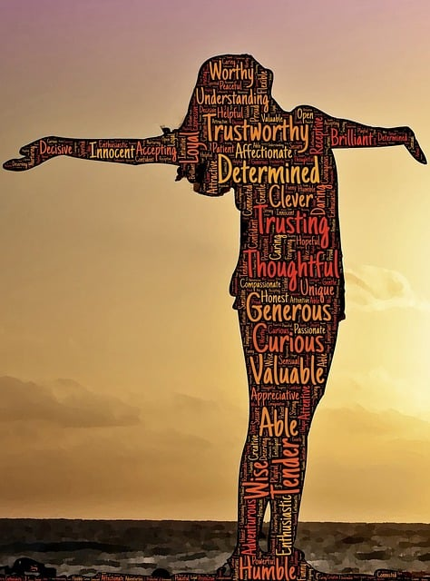
Action Planning
What have you taken away from out time together?
How can you apply this to your experience?
What three steps can you take in the next month to apply this?
What do you need to:
1. Stop doing?
2. Start doing?
3. And do more of?
Please complete the Course evaluation
77
Notes:
Make notes & discuss
Course evaluation & post it on Google & Trustpilot to be entered into the price draw
You’ll receive an email from GovPD soon with the materials.
https://docs.google.com/forms/d/e/1FAIpQLSeDanb9I73T_CQgtfjw7D5xQrR57PsfS4VWFMX6XdBL64looQ/viewform?usp=sf_link

